Slide 1

WELCOME TO
ST. JOSEPH’S HOSPITAL HEALTH CENTER
PHYSICIAN ORIENTATION

Slide 2
Introduction to Trinity Health

Slide 3

Trinity Health’s 22-state diversified system today
$19.3B
In Revenue
1.5M
Attributed Lives
$1.1B
Community
Benefit Ministry
125K
7.5K
Employed Physicians
& Clinicians
27.5K
Affiliated
Physicians
Colleagues
91
18
13
106
Hospitals*
in 22 states
Clinically Integrated Networks
PACE Center
Locations
Continuing
Care Locations
*Owned, managed or in JOAs or JVs.
Notes:
Our health system is a member of Trinity Health, one of the largest multi-institutional Catholic health care delivery systems in the nation, with 92 hospitals in 22 states coast to coast.

Slide 4
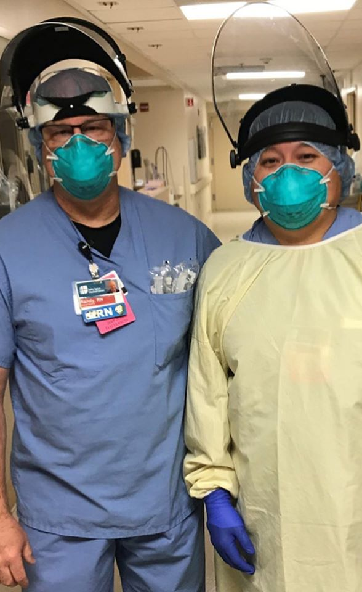
TogetherHealth:
Driving Our Strategy and Culture
- To Be The Most Trusted Health Partner For Life
Together, our colleagues and physicians serve the people in our communities as members of the Trinity Health family.
We care for all in body, mind and spirit, demonstrating that:
We Listen
We Partner in Achieving Health Goals
We Make It Easy
Notes:
Across Trinity Health, strategy and culture is driven by the goal to be the most trusted health partner for life – for people we serve, colleagues and physicians. With a holistic approach, we focus on listening, partnering and making things easy.

Slide 5
Trinity Health Values our Medical Staff Partners
We are committed to working closely with our medical staff members to build a health system to provide better care, better health at lower cost.
Our fiscally sound national ministry focuses on quality and provides you access to:
  A culture based on shared mission, values and vision – and driven to be the most trusted health partner for life
  Engaged colleagues who reflect the diversity of our communities
  Having a voice in decision-making
  Leadership on a national level
            Phenomenal collective knowledge
            Diverse clinical staffs across the country
            Resources and the ability to leverage skills and scale
            Advocacy at national, state and local levels
            Payer contracting
            Collaboratives that lead to establishment of national standards of practice
            Trinity Health National Accrediting body –ACCME for CMEs
            Teaching hospitals and international health programs
            Commitment to personal and professional health and resilience
Notes:
Being a medical staff member of this hospital means that you are a part of Trinity Health, and you will experience a culture based on a mission and values, engaged colleagues, having a voice in decision making and leadership on a national level which brings a number of benefits and connections.

Slide 6
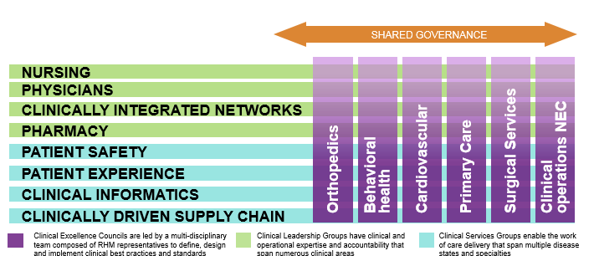
Clinical Framework teams create standard work for care redesign and delivery and are inclusive of clinicians from our ministries.
Clinical Framework
Clinical Excellence Councils (CEC)
Clinical Leadership Groups (CLG)
Clinical Service Groups (CSG)
Teams are interdisciplinary who address
  clinical variation
  TogetherCare documentation
  AND make the decisions regarding their work.
Graphic is representative and not intended to represent an accurate picture of all teams.
Notes:
Trinity Health has developed a framework that includes several groups focused on key services and comprised of representatives of key operational areas from the system office as well as the ministries to address clinical variation, TogetherCare (Epic) and other clinical decisions.

Slide 7
Clinical variation encompasses a wide array of variation and opportunities due to the multiple root causes that clinical framework teams address.
Clinical Choice
Products, resources, order sets
Care delivery: organization
CIN Practice variation, palliative care, LOS
Care delivery: clinician
Physician variation within a DRG, or practice
Appropriate care
Choosing Wisely, Evidence based care
Driven by organizational availability, existing standards
Driven by system workflows, state requirements
Driven by autonomy, history
Driven by workflows, practice patterns, history and autonomy
Clinical Variation
Unwarranted clinical variation
Notes:
The system strives to address opportunities to reduce variation where possible for not only cost savings but to ensure the best and most appropriate care across Trinity Health.

Slide 8

Clinicians across the ministries are also involved in the provision of feedback that supports framework team decision-making.
Each month hundreds of practicing clinicians are asked to provide feedback using the Clinical Leadership Update on the clinical work under consideration.
The clinician feedback loop plus the membership of the clinical teams place clinical decision-making in the hands of those doing the actual work.
Notes:
A Clinical Leadership Update is provided through the system office as a means to communicate new and pending decisions on clinical issues – and all medical staff are invited to share feedback.

Slide 9
Supply Chain Overview
Contracting for supplies and services is centralized and led by Strategic Sourcing
All clinical supplies are evaluated by Expert Panels to select products that offer the best outcomes and value
  Expert Panels for physician specialty items are comprised of practicing physicians utilizing the items under consideration
Ministries are accountable for compliance to the contracted portfolio of supplies
  Local Supply Chain Directors and/or operational leaders should be contacted to confirm items and services included in the Trinity Health contract portfolio
  Requests for use of non-contracted physician specialty items is considered by a physician led exceptions review committee
Supply Chain Governance
Ministry Leadership Council
Strategy Validation & Approve Implementation Plan
Local Clinical & Administrative Engagement:
Supply Chain Operations Steering Team (SOST)
Strategy Review, Confirm Change Management/Implementation Plan & Presentation of Strategy
Expert Panel
Analytics, Strategy Definition, Negotiation, Contracting, Change Management/Implementation Planning & Presentation of Strategy
Notes:
If you are wondering about a particular type of equipment, supply or pharmaceutical, check with the appropriate operational leader (e.g. Director of Surgery, etc.) to learn about specific equipment or supply is used here.

Slide 10
Medical Staff/Physician Leadership at the System Office
Dan Roth, MD, Executive VP, Chief Clinical Officer
Tammy Lundstrom, MD, JD, Senior VP, Chief Medical Officer
Mark LePage, MD, Senior VP, Medical Groups and Ambulatory Strategy
Emily Brower, Senior VP, Clinical Integration
Tom Peterson, MD, VP, Chief Safety Officer
Muriel Beene, Senior VP, Chief Health Information Officer
Anne Wynne, Director, Medical Staff Services/CPI
Sandy Hess, Director, Clinician Partnership
Notes:
These are some of the individuals from the clinical leadership at the system office who work closely with our CMO and others to provide support and guidance for our medical staff and clinical services.

Slide 11
INTRODUCTION AND INSTRUCTIONS
Welcome to St. Joseph's Hospital Health Center, it is our desire to educate you on the infrastructure and important policies of our organization prior to your first day of patient care.
This presentation provides you with mandatory educational material which includes essential information on topics required either by law or by external regulatory agencies.
Instructions:
Please read this presentation in its entirety. If you have any questions about the content, please consult with the Medical Staff Services Department. Contact information is provided to you within the “Contact Information” section of this presentation.
To ensure that you receive your SJHHC ID badge prior to your first day of patient care, you must print off, sign, and return the following documents:
Physician Orientation Attestation
Physician Orientation Evaluation
Your ID Badge will be issued upon return of the completed forms to the Medical Staff Office.

Slide 12
Credentialed Provider Mandatory Education
*All credentialed providers are expected to abide by Medical Staff Rules & Regulations,
Medical Staff Bylaws, and St. Joseph’s Hospital policy
Professionalism
Medical Staff Code of Professional Behavior
In order to promote and support the mission and values of St. Joseph’s Health, all members of the St. Joseph’s community are expected to maintain the highest level of professional behavior, ethics, integrity and honesty, regardless of position or status. It is the policy of the Medical Staff that all credentialed medical providers shall conduct themselves in a professional and cooperative manner, and shall not engage in disruptive behavior. Disruptive behavior has a negative impact on the quality of patient care, as safety thrives in an environment that values and promotes cooperation and respect for others.
Ethical and Religious Directives for Catholic Health Care Services
St. Joseph’s Health, as a Catholic Health care provider and regional health ministry, abides by the Ethical and Religious Directives for catholic Health Care Services. In order to support our mission, values and catholic identity, all members of the St. Joseph’s community are expected to review and abide by the ERD’s upon appointment to the medical staff.

Slide 13
Professionalism - continued
Sexual Harassment
All members and affiliates of the Medical Staff are responsible for assuring that the workplace is free from sexual harassment. The hospital strongly disapproves of offensive or inappropriate sexual behavior at work. It is expected that all members and affiliates of the Medical Staff will avoid any action or conduct that could be viewed as sexual harassment.
Workplace Violence / Disruptive Behavior
NYS Labor Law Section 27- B. Workplace Violence is any physical assault, threatening behavior, or verbal abuse, occurring in the work setting. Report incidents by submitting in MIDAS, or through reporting to your Department Chair, immediate supervisor or to Corporate Compliance at 448-6484.

Slide 14
Medical Staff Services
CONTACT LIST:
Sandra Sulik MD, VPMA_______________________________________________ (315) 448-5880
Kelly Gressel– Manager, Medical Staff Services ___________________________ (315) 448-5683
John Cerniglia – Physician Recruiter ____________________________________ (315) 396-4364
Lindsay Walsh – Physician Onboarding Specialist ________________________ (315) 729-7404
Medical Staff Office –
Sue Dunn – Anesthesia, Emergency, Internal Medicine ___________________ (315) 448-6569
Jeanne Steckel – OBGYN, Musculoskeletal, Pediatrics, Surgery ____________ (315) 448-5878
Louise Wombacker – Dental, Family Medicine, Pathology, Psychiatry, Radiology (315) 448-5321
Payor Enrollment –
Kathy Ackerman – Coordinator_______________________________________ (315) 744-1865
Deb Dalfonso – PCC West & Main, Behavioral Health (CPEP, 3-6, etc.), ______ (315) 744-1478
Justin Lasher – Hospital Based Clinical Affiliates, Hospitalists, Intensivists ____ (315) 448-5660
Dawn Valentino – SJPhysicians______________________________________ (315) 744-1819
Contract Management–
Melissa Madigan - _________________________________________________ (315) 448-2783

Slide 15
Key Contact List
HOSPITAL or Health PC Providers
Administration Main Number ___________________________________________ (315) 448-5880
IT Help Desk ________________________________________________________ (315) 448-5607
Tom Wentworth – Coordinator, Security & Parking_________________________ (315) 448-6385
Employee Health Office _______________________________________________ (315) 448-5581
Human Resources ___________________________________________________ (315) 448-5575
Health Information Management Main Line_______________________________ (315) 448-5160
Renee Riley – Coding for the Hospital____________________________________ (315) 448-6110
Tracey Westerlund - Coding for Med PC and Health PC_____________________ (315) 448-5562

Slide 16
m i s s i o n
We, St. Joseph’s Health and Trinity Health, serve together in the spirit of the Gospel as a compassionate and transforming healing presence within our communities
v a l u e s
v i s i o n
St. Joseph’s will be a leading regional health system of choice serving and providing value to the communities of Syracuse and Central New York
reverence
commitment to
those who are poor
justice
stewardship
integrity
excellence
o u r r o o t s
Inspired by our Franciscan Tradition, we are passionate healers dedicated to honoring the Sacred in our sisters and brothers

Slide 17


Slide 18

St. Joseph’s Health: FY2017 Operational Plan
DRAFT 9/20/16
STRATEGIC FOCUS AREAS |  | FY17 GOALS |  | June 30, 2017 Target Metrics | VP: | MD:
 | EOPLE-CENTERED CARE Strategic Focus #1: We will transform our clinical and business models to deliver people-centered care. | G 1.1 | Physician Alignment | Develop and implement the infrastructure to support Track 3 ACO participation according to the system office Standard Operating Model, with targeted attribution of 65,000 patients. | FL | PF
 |  | G 1.2 | Clinical Quality | Reduce unplanned 30 day readmissions in our accountable populations. Composite Target 17.2% | MM/FL SYSTEM | SS
 |  | G 1.3 | Clinical Quality | Reduce Hospital Acquired Infections. Composite Target 0.87 | SS/AMC SYSTEM | SS
 |  | G 1.4 | Patient Experience | Improve Likelihood to recommend scores HCAHPS-Target 79.8% ED-CAHPS-Target 69.8% and CG-CAHPS-Target 86.7% | DW | JB
 | NGAGED COLLEAGUES Strategic Focus #2: We will attract, develop and retain exceptional and committed colleagues who reflect the diversity of our communities. | G 2.1 | Colleague Engagement | Improve colleague retention rate to 87%. | ED/AMC | TBD
 |  | G. 2.2 | Colleague Engagement | Improve employee engagement score from the 3.92 to 3.97percentile | ED | JB
 |  | G. 2.3 | Colleague Engagement | Improve employee engagement survey participation rate from 68% in FY16 to 75% in FY17. | ED | JB
 | PERATIONAL EXCELLENCE Strategic Focus #3: We will build an enterprise that uses our strengths as a national system to deliver operational excellence. | G 3.1 | Transforming Operations | Achieve total Transforming Operations budget impact of $33.6M. | MP/AMC/JS/ED | HSOC*/ DC
 | HYSICIANS & CLINICIANS Strategic Focus # 4: We will collaborate with physicians and clinicians. | G 4.1 | Physician Expansion | Recruit 6 of Family Medicine Residents to practice with St. Joseph’s Health or an affiliate. | MM/FL | JT
 |  | G 4.2 | Physician Engagement | Develop a “Network Keepage Scorecard” for the CIN and ACO, outlining retention opportunity goals for key services vs. associated baselines. | FL/MM | PF
 |  | G. 4.3 | Physician Engagement | Implement PNO scorecard with goals for all employed physicians. | FL | PF
 | EADERSHIP REGIONALLY Strategic Focus #5: We will lead in strengthening and expanding the ministry of Catholic health care in our communities and nationwide. | G 5.1 | Strategic Growth | Complete business plans for the strategic growth of Women's Health Service line and Surgical Market Share | MM | BSC**
 |  | G 5.2 | Strategic Growth | Achieve Cardiac Master Plan project milestones, including System Office approval, CON process completion, selection of all equipment, and on-schedule development of design and construction documents (target 8/2017 completion). | JS/AMC | BSC**
 |  | G 5.3 | Community Health | Implementation of the two primary system goals: 1) implement portfolio of initiatives to reduce tobacco use and obesity, and 2) achieve targeted % patient tobacco screening and cessation referral. Targeted goal = achievement of maximum threshold 9/10 points | DW/MM | UI
 | FFECTIVE STEWARDSHIP Strategic Focus #6: We will steward resources effectively to enable success in our transformation to people-centered health care. | G 6.1 | Resource Stewardship | Operating Margin (50% weight) | ALT SYSTEM | CM
 |  | G 6.2 | Capital Management | Cost Per CMAED (50% weight)** | ALT SYSTEM | MP
P
E
O
P
L
E
HSOC * - Health Systems Operations Council BSC** - Board Strategy Committee

Slide 19








People-Centered 2020: Our Strategic Plan Includes Five Focus Areas to Achieve Our Vision
People-Centered Care
Engaged Colleagues
Operational Excellence
Leadership Nationally
Effective Stewardship
Physician and Clinician Collaboration
Notes:
Our Strategic Plan Includes Five Focus Areas to Achieve Our Vision
To transform care delivery across the continuum, we will need to find new ways to collaborate and partner with our physicians and clinicians. The care delivery model will require building a team based people-centered approach.

Slide 20
Meet our Administrators
(click here)

Slide 21
Hospital POLICIES
Confidentiality
Identification Badge
Smoking
Drug Free Workplace

Slide 22
CONFIDENTIALITY OF PATIENT INFORMATION
This applies to patient information in any format including paper,
electronic and verbal communication.
Do not access patient information unless it relates to a patient under your care.
Protect all printed or computerized information concerning patients from unauthorized access by other persons.
Do not leave medical records or patient information lying out unattended and log-off of the computer application before you leave the computer.
Do not access medical information concerning yourself, or your family members unless you need it to do your job.
St. Joseph’s policies on medical record confidentiality may be found in the Hospital Policy and Procedure Manual.
Do not share computer passwords or remote access devices with anyone, including administrative assistants or secretaries.
You are responsible for all activity that occurs under your personal login (includes Physician Portal).
Should your password be used for inappropriate access, you will be subject to sanctions, up to and including loss of staff privileges, and legal action by the hospital, patient or any other injured party.
St. Joseph’s policies on password usage and confidentiality may be found in the Hospital Policy and Procedure Manual.

Slide 23
IDENTIFICATION BADGE
Upon completion of the Physician Orientation Program, you will be issued an identification badge with your photo on it. The badge will provide authorized entry into buildings, a tool for the security of the campus.
In accordance with the New York State Department of Health Code 405: Rules and Regulations for Hospitals, all St. Joseph’s Hospital personnel working or doing business, must wear an identification badge at all times when working throughout St. Joseph’s Hospital Campuses, including owned or leased areas.
The badge allows you access to the Physician Lounge.
Identification badges must be worn at all times, in a visible location on the front of the upper torso, to gain access to hospital owned property.
Please do not cover your SJHHC Badge with other local hospital issued badges while you are on our campus.
If you lose your identification badge, you must replace it immediately.
Identification badges must be surrendered to the Medical Staff Office in the event you terminate your Medical Staff Privileges.

Slide 24
TOBACCO FREE CAMPUS
It is the policy of St. Joseph's Hospital Health Center and our affiliate corporations to provide an environment free of tobacco use.
Individuals covered by this policy include, but are not limited to, employees, patients, visitors, volunteers, physicians, residents, students, medical staff, contractors and vendors, with the exception of Behavioral Health Residences.

Slide 25
SMOKING AND TOBACCO USE IS PROHIBITED
On all St. Joseph’s owned and leased property and areas clearly identified as “St. Joseph’s Hospital Health Center.”
In all St. Joseph’s owned and leased buildings, including the Network Sites.
In parking garages and parking lots owned by St. Joseph’s.
In St. Joseph’s owned vehicles and personal vehicles while on St. Joseph’s owned property.
Sidewalks contiguous to the properties owned or leased by St. Joseph’s.
Click here for Full Policy

Slide 26
DRUG FREE WORKPLACE
St. Joseph’s Hospital Health Center recognizes that substance abuse (drugs and alcohol) creates serious health and safety problems for its workers, while also negatively affecting the quality of patient care.
The Medical Staff at St. Joseph’s Hospital Health Center has an established Health Committee. A Physician may self- refer to this committee, or be referred by a colleague.
Additional information regarding the Health Committee can be found in the Medical Staff Rules and Regulations.
Click here for policy

Slide 27
ENVIRONMENT OF CARE AND SAFETY
  Emergency response codes
  Fire response procedures (R.A.C.E.E.)
  Radiation Safety
  Hazardous Materials & Waste
  Security Contact & Additional Information
  Infection Control
Notes:
New Employee EOC Orientation
27

Slide 28
Emergency/Disaster Operations Plan
E-DOP Overhead Paging System CODES (1/2013)
Code A - Alpha | Alerts staff of an infant/Minor abduction
Code B - Bravo | Activates the Hospital Command Center (HCC)
Code C - Charlie | Alerts necessary personnel for an OB Emergency
Code D - Decon | Decontamination teams activated
Code F – Foxtrot | Facility evacuation as directed by Administration or Fire Chief
Code G – Gray | Behavioral Health Rapid Response Team
Code I – Ivan | An unexpected mass influx of patients is occurring, Surge Capacity Procedures in effect
Code L – Lockdown | Activates house lockdown and traffic control procedures for Level 1, 2 or 3 Lockdown
Code M – Mike | Calls additional security staff to an area
Code P – Papa | Patient discharge to open beds for emergency/disaster operations
Code R – Red | Fire Alarm (R. A. C. E. E.) Rescue, Alarm, Confine, Extinguish, Evacuate
Code S – Sierra | Bomb Threat
Code T – Tango | Active Shooter Response
Code W – Weather | Severe weather warning. Staff cannot leave without contacting manager/administrative coordinator
Code X – X-Ray | Chemical, Biological, Radiological, Nuclear, Explosive (CBRNE) Event Response
Notes:
New Employee EOC Orientation
28

Slide 29
FIRE DRILLS
St. Joseph’s conducts fire drills in accordance with regulatory requirements.
  Clinical Areas: 1 drill per shift per quarter
All staff are required to participate in fire drills.
All fire drills are evaluated to identify deficiencies and opportunities for improvement.
Notes:
New Employee EOC Orientation
29

Slide 30
“R.A.C.E.E.”
R. – Rescue
A. – Alarm
C. – Confine
E. – Extinguish
(if comfortable)
E. – Evacuate
"Code
R - Red"
Notes:
New Employee EOC Orientation
30

Slide 31
R.
RESCUE or remove all individuals from the immediate area.
Pull fire ALARM AND Call Security: On-Campus: 5555 Off Campus: 911
CONFINE the fire by closing ALL doors: At the fire’s point of origin,
Patient Rooms, corridors, offices ….
EXTINGUISH the fire if you are comfortable with using Fire Extinguisher
EVACUATE patients IF ONLY directed by Fire Chief
Follow the area specific fire evacuation plan or route
A.
C.
E.
E.
Notes:
New Employee EOC Orientation
31

Slide 32

Radiation Safety
In the hospital we use radiation producing equipment and radioactive materials to diagnose and treat patients. Radiation exposure to workers should always be ALARA (as-low-as-reasonably-achievable). There are several radiation areas throughout the hospital. If there is a potential for radiation exposure there will always be a radiation warning sign nearby, like the one shown here.
If you are asked to work in an area where this sign is posted, you should receive instruction before working in this area. If you do not know, then ask your supervisor or a staff person working there
If there is an emergency involving a radiation area, then call Security at x5555 as you would for any emergency. Security knows who to contact to take care of these areas. Never be afraid to ask questions!!

Slide 33
Hazardous Materials & Waste
Material Safety Data Sheet (MSDS)
MSDS's contain information such as the names of chemicals, name of the manufacturer, specific health hazards, first aid, PPE(Personal Protective Equipment) to be used, spill procedures, disposal procedures, and much more.
A master listing of MSDS's is maintained in the Employee Health Office and in the Emergency Department.
Part of the Right-to-know includes ready access to Materials Data Safety Sheets (MSDS) for the chemicals that you are required to use. Materials Data Safety Sheets for all chemicals used in the hospital can be obtained from:
  The hospital intranet using MSDSPRO
  The Employee Health Office
  The Emergency Department
  Or from your supervisor
All Hazardous Materials require a Hazardous Materials Label. When transferring a hazardous material from one container to another unmarked container you are responsible to label the new container.

Slide 34



Hazardous Materials & Waste (cont.)
Labeling of Hazardous Chemicals
All chemical containers must be labeled and at a minimum, the label must contain the proper name of the chemical, name and address of the manufacturer, and the hazard associated with that chemical.
If a chemical is transferred from its original container into another container for any other reason you must label that container.
NOTE: If the container will be in your possession only, and will be completely used up or disposed of when you are finished with it, then no labeling is required.
Hazardous Material Labels use numbers from 0 to 4 to indicate the hazard from the least to most severe hazard. The color indicates the type of hazard.
Red = Fire Hazard
Blue = Health Hazard
Yellow = Reactive Hazard
White = Type Of Chemical

Slide 35
Hazardous Materials & Waste (cont.)
Hazardous Materials Spill Procedures:
The hospital uses three 3 levels of response to a hazardous materials spill. These response levels are referred to as Tier One, Tier Two and Tier Three.
A Tier One Spill can be cleaned up by either staff or housekeeping personnel. This type of spill does not require Personal Protective Equipment (PPE) and the waste materials can be disposed of using the municipal waste stream.
A Tier Two Spill is cleaned up by Facilities Services Maintenance personnel using Personal Protective Equipment (PPE) and the waste materials are disposed of as Hazardous Waste.
A Tier Three Spill is one that we cannot handle in-house. We contract with a professional hazard abatement contractor to clean up the spill.

Slide 36
Hazardous Materials & Waste (cont.)
Properly Separate Regulated Medical Waste
Any waste contaminated with blood or body fluids to the point of saturation is considered regulated medical waste and should be placed in Red bags. Pathological waste, while considered regulated medical waste, must be packaged separately.
"Sharps" are also considered Regulated Medical Waste and shall be disposed of in the appropriate "Sharps" containers.
If the waste does not fit the above criteria it is considered municipal waste, recyclable waste, or hazardous waste.
Fact: On average, 4 Housekeepers per year are stuck from needles discarded in the trash.

Slide 37
Hazardous Materials & Waste (cont.)
MUNICIPAL WASTE (Not considered Regulated Medical Waste:)
Regulated waste does NOT include packaging of medical supplies, gloves, barrel syringes not in contact with infectious agents or bandages not saturated with blood or body fluids, etc. Other examples of non-regulated medical waste include IV bags and their associated tubing, urine & stool (unless they contain visible blood, have been submitted as a specimen or are known to have a transmissible disease), feminine hygiene pads, and general waste from isolation rooms.
These items are considered municipal waste and should be placed into a clear trash bag or a recyclable waste container.
Confidential recyclable waste is handled separately on a call for pick up basis. Facilities arrange for 3rd party pick up, and they then provide documentation of destruction.
Fact: Regulated Medical Waste costs $.20 per pound more than regular waste to dispose of and when properly separated, only makes up 20% of the total waste. If we were to consider that our current monthly volume is 107,000 lbs. the monthly cost would be $27,000.00 / month. (A reduction goal of 80% would equate to a savings of $21,436.00 / month. The yearly savings would be approximately $257,000.00.)

Slide 38
Hazardous Materials & Waste (cont.)
MUNICIPAL WASTE (Not considered Regulated Medical Waste:)
Municipal waste can be disposed of in local Landfills or recycled through the Onondaga Resource Recovery Agency. (OCRRA)
Municipal waste is placed in clear plastic bags. This waste stream includes food products, glass & metals, plastic tabs, wire spirals, Styrofoam label backing, carbon paper, tyvek envelopes, and rubber bands. Glass and metals are placed in the same containers marked for municipal waste.
Paper is placed in recycling containers for pick up and recycling. Recyclable items include white paper, fax paper, junk mail, catalogs, folders, newspapers, envelopes, colored paper, etc. Staples and labels do not have to be removed. Cardboard packages or boxes are to be broken down flat prior to pick up and recycling.

Slide 39

SECURITY CONTACT INFORMATION
Security Personnel Posted:
  Main Lobby
  Emergency Department
  Vehicle/foot patrols
Emergency Phone Numbers:
  On Campus: 5555
  Off-Campus: 911
Non-Emergency: 448-5173
Notes:
New Employee EOC Orientation
39

Slide 40
SAFETY
St. Joseph’s Campus is subject to the same criminal activity as the rest of the City of Syracuse.
For your Safety:
  Wear your St. Joseph’s I.D. badge properly
  Lock up when you leave
  Secure your personal belongings
  Lock your car and take your keys
  Don’t leave things in your car where they can be seen
  Report suspicious activity
  Call for an escort to your vehicle
Notes:
New Employee EOC Orientation
40

Slide 41
INFECTION CONTROL
Hand Hygiene is the single most effective way to prevent the spread of infection among staff and patients.
All providers, including physicians, are required to perform hand hygiene using either soap and water or hand sanitizer prior to and following each patient encounter.

Slide 42
INFECTION CONTROL
5 moments for Hand Hygiene defined by World Health Organization and CDC:
1. Before patient contact (and between contact with different sites on the same patient)
2. Before Aseptic Task (performing any invasive procedure/prior to putting on sterile gloves)
3. After Body Fluid Exposure Risk
4. After patient contact (after removing gloves)
5. After contact with patient surroundings
Minimally, hand hygiene is required with every entry and exit of a patient’s room, regardless of anticipated contacted with the patient.
Hand wash: requires15-20 seconds of friction under running water/required for all care of patients with C. difficile on Contact Precautions
Alcohol Gel/Foam: When hands are not visibly soiled/ appropriate for same conditions listed above with exception of C. difficile patients

Slide 43
INFECTION CONTROL
OSHA Blood Borne Pathogen Standard
Blood and body fluids of all patients are to be considered potentially infectious without regard to their medical diagnosis. Wear a surgical mask when placing a catheter, accessing or injecting material into the spinal canal or subdural space (includes lumbar punctures, intrathecal injections, etc.)
All physicians and other providers must use Standard Precautions to protect their skin and mucous membranes from exposure to blood or any other body fluids of another person, with the exception of sweat.
  You must use Personal Protective Equipment (PPE), whenever there is a risk for exposure to these fluids.

Slide 44
INFECTION CONTROL
Types of isolation at St. Joseph’s include:
  Contact Precautions – eg C diff, MRSA, VRE
  Airborne Precautions – eg TB, disseminated Varicella
  Droplet Precautions – eg flu, meningococcal meningitis
Read the isolation sign prior to entering the room of a patient on isolation, and follow the appropriate instructions.
If you anticipate the need to see patients with possible tuberculosis, please call the SJHHC Employee Health Office and request fit testing for the appropriate N95 mask. This will help ensure your safety when called upon to see such patients.

Slide 45
INFECTION CONTROL
Red trash bags with a biohazard label must be used for the disposal of any waste saturated with blood or body fluids
Compliance with hand hygiene and isolation precautions will be monitored. Lack of compliance may be reported to the Vice President for Medical Affairs.

Slide 46
INFECTION CONTROL
Sepsis
Incidence of sepsis is increasing. Severe sepsis and septic shock have substantial mortality. Early recognition and prompt institution of sepsis protocol can improve outcomes. Any patient who meets SIRS criteria or Sepsis should have a lactate level and antibiotics administered within 1 hour; time is critical. In accordance with the international Surviving Sepsis Campaign, the following elements should all be completed within 3-hours of presentation:
Measure lactate level – Lactate levels > 2mmol/L with a suspected infection is indicative of Severe Sepsis
Obtain blood cultures prior to the administration of antibiotics
Administer broad spectrum antibiotics
Administer 30ml/kg crystalloid for hypotension or lactate >2mmol/L

Slide 47
INFECTION CONTROL
Evidence Based Prevention Strategies for:
Central Line Associated Blood Stream Infections (CLABSI): Aseptic insertion and daily review of necessity/possible alternatives
Catheter Associated Urinary Tract Infections (CAUTI): Assessment of need prior to insertion, aseptic insertion, and daily review of necessity/possible alternative.
Surgical Site Infections (SSI): Evidence-based preoperative antibiotics, temperature control, blood sugar control, clean closure techniques, and evidence-based postoperative dressing and wound management
Multidrug resistant organisms (MRSA,VRE, CRE,C. difficile and others): Hand hygiene, appropriate isolation, readmission notifications, high touch surface cleaning, UV light disinfection

Slide 48
INFECTION CONTROL
Reporting:
Communicable Disease Exposures: Contact Employee Health Mon.-Fri. 7:30am-4PM; all other times contact Administrative Supervisor
Blood & body fluid exposures: Contact Employee Health Mon.-Fri. 7:30am-4PM; all other times report to Emergency Department for evaluation and care.
Safe Injection Practices:
In response to national hepatitis outbreaks, the CDC and the New York State Health Department have defined safe injection practice. All licensed personnel must comply with these standards. This applies to: use of needles, cannula that replace needles, and intravenous delivery systems.
One needle, one syringe, one time. No reuse of needles or syringes for more than one patient / no reuse to draw up additional medication
Limit use of multi-dose vials and dedicate them to a single patient whenever possible
Do not administer medications from a single dose vial or IV bag to multiple patients

Slide 49
INFECTION CONTROL – Annual Flu Vaccine Requirements
All health care personnel affiliated with St. Joseph’s, both employed and non-employed, are required to be immunized against the flu annually, either by our Employee Health Office or one of its designees, or provide proof of receiving the vaccine elsewhere.
If you chose not to be vaccinated, a declination statement must be signed and on file. Those who do not receive the vaccine will be required to wear a surgical mask for any/all patient contact during the flu season.

Slide 50
General Information
Parking
Communication
Mandatory In-services
Portal Access
Patient Identification
Interpreter Services
Peer Defusing Program
TeamSTEPPS

Slide 51
PARKING
There are 2 lots specifically designated for physicians at the hospital, however physicians may park in any surface lot throughout the campus.
Garage parking in either the MOC or POB is available for a monthly fee.
The Security office can assist you with registering for a parking permit, for either lot or garage parking.
Please bring vehicle information such as make, model and plate number as this is required.
Parking permits should be affixed to the lower right corner of the rearmost window on the driver’s side of the vehicle. Those driving a second or third vehicle may receive a permit for each vehicle, but only one gate box card will be provided.
If a replacement permit is required, contact the Coordinator of Parking at 448-6385.

Slide 52
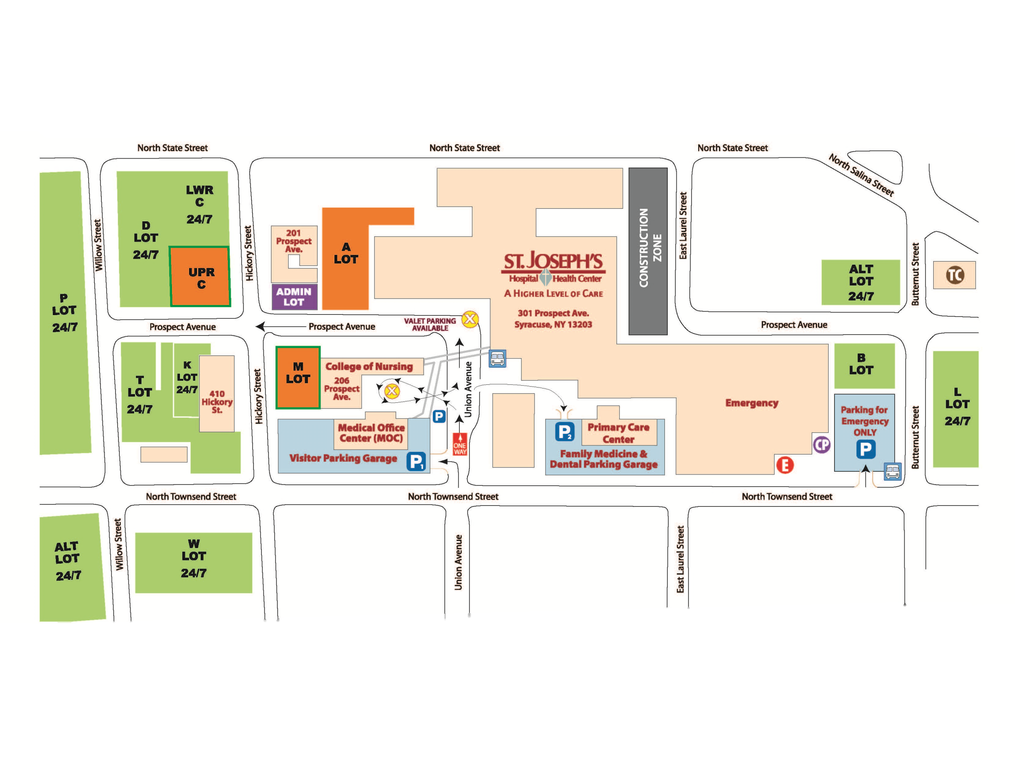
Campus Map

Slide 53
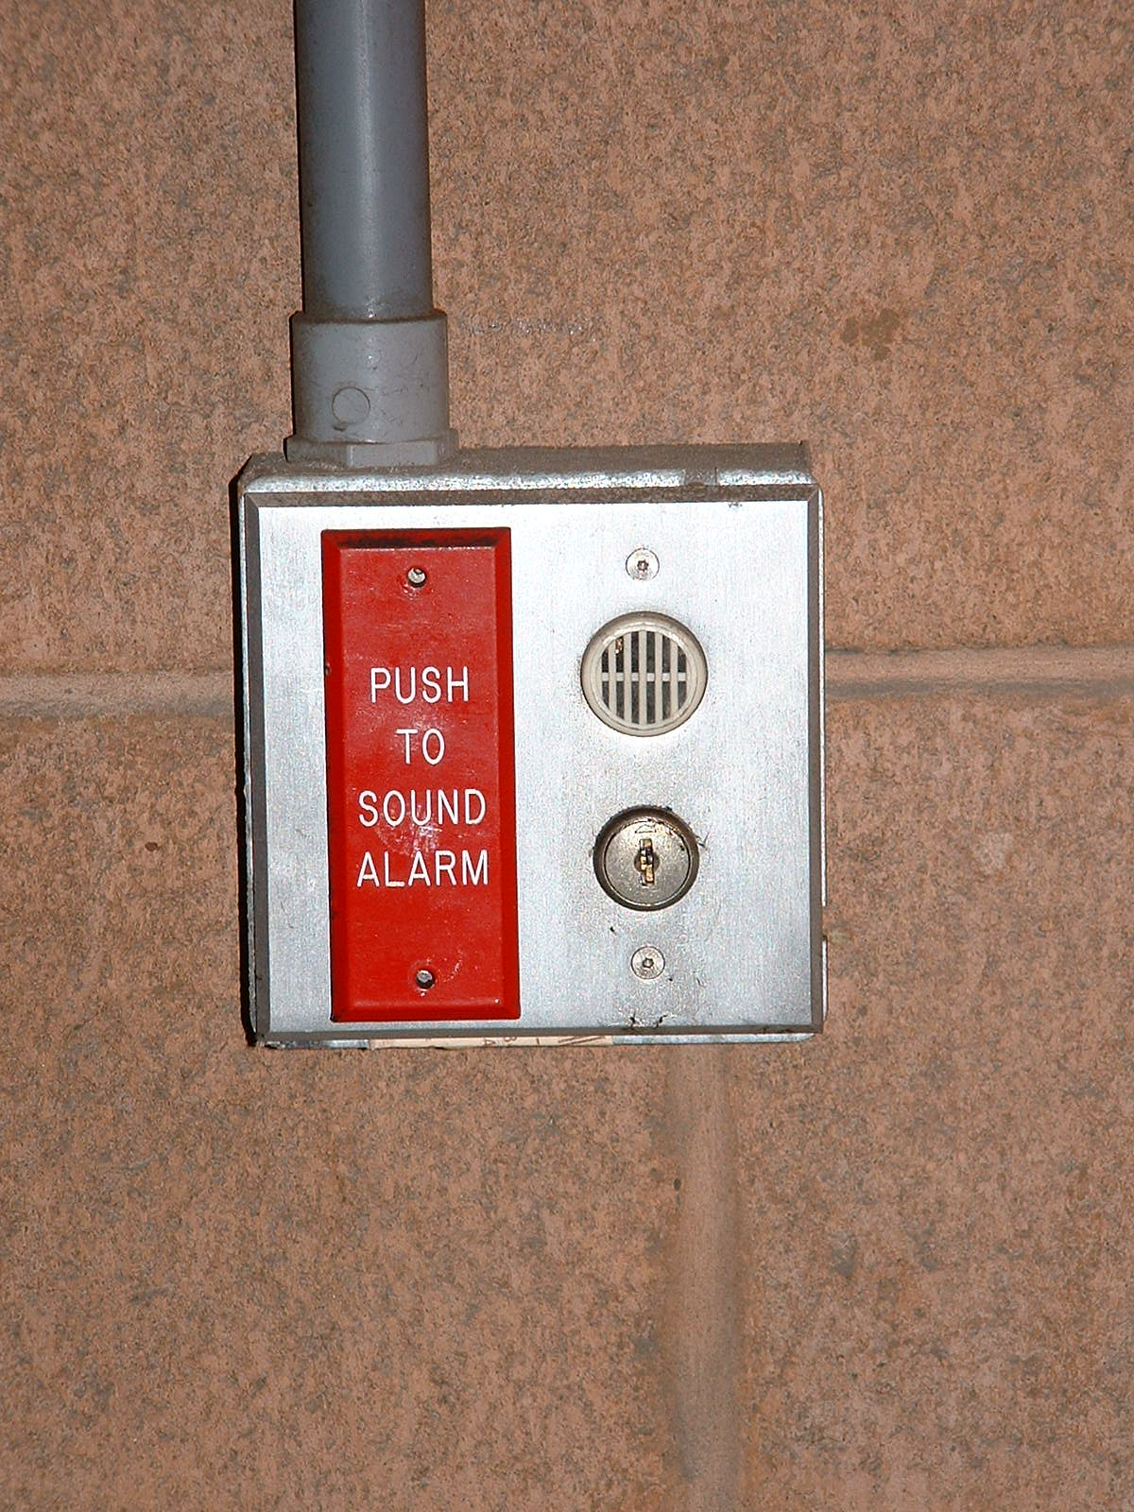
ESCORT SERVICE and ALARM SYSTEM
Call 448-5173 to request a security escort TO or FROM your vehicle. There may be a short wait based on Security Officer availability.
Alarms are located in the parking garages.
Notes:
New Employee EOC Orientation
53

Slide 54
PHYSICIAN COMMUNICATIONS
Monday Medical Staff Briefing:
The Monday Medical Staff Briefing is a special communication for credentialed members of the St. Joseph's Medical Staff, with essential news and information. It is distributed every Monday afternoon from the President of the Medical Staff.
SJEN (St. Joseph’s Employee Network – Intranet):
Internet site with links to By Laws, Rules & Regulations, Policies, Mandatory Competencies, Physician Recognition, and Physician Events. This site is available both on the traditional and mobile version of the website.

Slide 55
MANDATORY IN-SERVICES
Throughout the year there are several mandatory in-services that all members of the Medical Staff are required to complete.
CME credits are sometimes offered for competencies and they are all accessible at: http://www.sjhsyr.org/physicians/in-services

Slide 56
Patient Identification
"Why do you need to look at my bracelet? You looked at it yesterday"...
Patient Identification:
We need to carefully identify each patient, using the patient’s full name and either the medical record number or account number, every time we provide care for them in order to prevent the RISK of serious error. This includes: when admitting a patient, giving medication, transporting, or performing any procedure or diagnostic studies.
Remember TWO identifiers must be used each time.
The patient(and as needed the family) will be actively involved in the identification and verification(matching) process.
Patients must be always be identified by the nurse or staff member that has responsibility for the patient. The only exception is the patient access representative that performs patient registration.
"I need to check your bracelet every time I care for you!"

Slide 57
Interpreter Services
By law, we must provide an interpreter within 10 minutes to patients in the ED and within 20 minutes to all other patients within the inpatient & outpatient setting.
Use of Patient’s family members & friends as interpreters is not allowed – UNLESS, the patient has refused the hospital’s interpretive services. This must be documented in the medical record.
The Blue Cyracom phone is a way we access an interpreter for a patient who has limited English proficiency (LEP) – 24 hour Access 1-800-481-3293
For face-to-face interpreters for LEP patients call the Multicultural Association Medical Interpreters (MAMI) at (315) 214-5003
For 24/7 Emergency Interpreting Services call (315) 624-0953
Interpretive Service Policy and List of Resources
Documents may be accessed & printed from the Hospital Intranet under ONLINE FORMS: Translated Forms: http://sjen.sjhsyr.org/him-pdf-forms/translated-forms

Slide 58
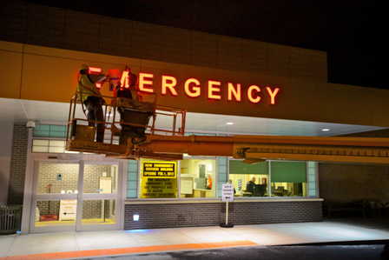
Interpreter Services @ SJHHC
The patient is given an ID Card by the registration staff to designate
their language preference.
Medical Record documentation of the patient's language preference, language needs and acceptance or refusal of language assistance services must be completed. The ID of the telephonic interpreter used must also be documented.
Only staff that have been certified in medical terminology and in the language they speak by the SJHHC contracted interpretation service may interpret for patients with limited English proficiency.
Critical document translations are available in the most prevalent non-English languages seen at SJHHC. This includes Vietnamese, Spanish, Russian, Ukrainian, & Arabic.
In addition to signage, notification to patients of their right to free interpretive services is included in the Inpatient & Outpatient handbooks and on the hospital's website.
Limited English Proficient Patient (LEP), Hard of Hearing (HOH) and Visually Impaired
Patients are screened during the admission process for Interpreter Needs

Slide 59
Interpreter Services @ SJHHC
Communication of language needs must occur during the patient hand - off process.
St. Joseph's Hospital Health Center provides interpreter services consistent with the Americans with Disabilities Act and relevant Federal and State Laws. The SJHHC Interpreter Services Policy applies to all programs, employees, volunteers, physician affiliates, students and facilities.
Documentation in the patient's medical record must be done each time interpreter services and or equipment is used.
Use of Patient's family members & friends as interpreters is not allowed - UNLESS, the patient has refused the hospital's interpretive services. This must be documented in the medical record.
Individuals younger than 16 years of age may not be used as interpreters except in emergent circumstances.

Slide 60
PEER DEFUSING PROGRAM
St. Joseph's Hospital Health Center recognizes the stressfulness and critical nature of the work we all do on a daily basis. Consistent with our Mission, Vision and Values with being passionate healers we have developed a Peer Defusing Program
Assisting health care workers to accelerate closure/recovery from a stressful incident
PEER DEFUSING SUPPORTS:
Decreased:
  Stress
  Burnout
  LOAs
  Risks
Increased:
  Satisfaction
  Retention
  Performance
  Quality
  Safety
Staff service recovery
  Takes immediate temperature of involved staff
Emotional and process improvement
  Two-sided feedback loop
  Confidential reports generated to ensure follow-up
Collegiality
  Improves associations
More information can be found on the Peer Defusing webpage on the intranet (only available within the hospital network): http://sjen.sjhsyr.org/ho-peerdef

Slide 61
TeamSTEPPS:
Strategies & Tools to Enhance Performance and Patient Safety

Slide 62
New Approaches
AIDET
Customer Service
CUSE
Mutual Support
SBAR/CHAT
Communication
DESC
Conflict Resolution
Notes:
We’re going to talk now about new approaches to
Customer Service
Mutual Support
Communication
Conflict Resolution
These are like the “plays” in a football game that the quarterback calls after the team “huddles” -- he calls out, “ “#14 – Shift !” “#29 –Pass!” )

Slide 63
What is AIDET
Simple acronym that represents a powerful way to communicate with people who are feeling anxious and vulnerable.
Acknowledge
Introduce
Duration
Explanation
Thank You

Slide 64
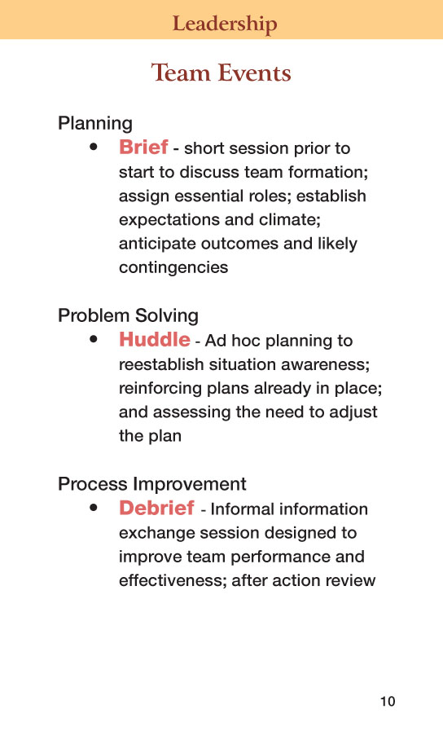
Notes:
Why is it important to plan, problem solve, and focus on continuous improvement?
(Refer back to Employee Survey & Patient Satisfaction Survey )

Slide 65
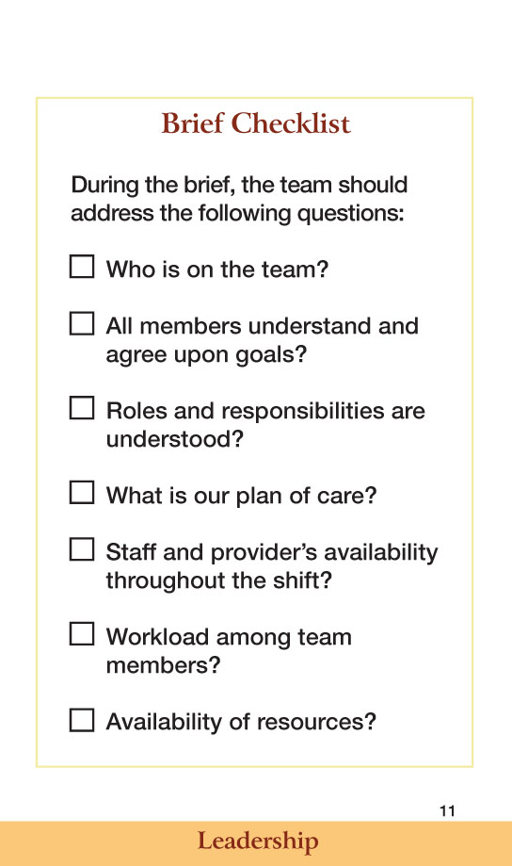
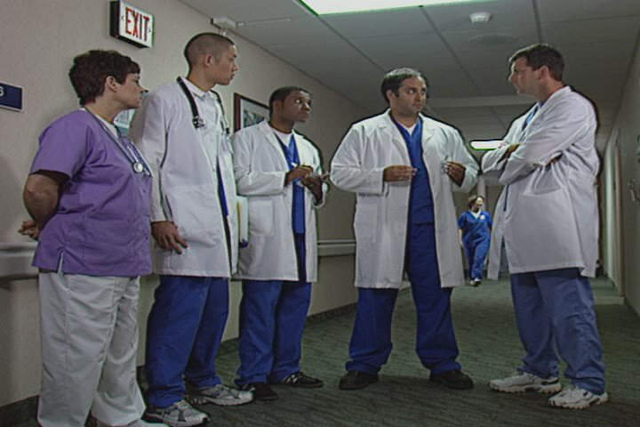
Notes:
Here’s what we can use for a script for “how ” to approach the work today
This approach applies to ALL departments
This is our mental check-list every day when you come to work

Slide 66
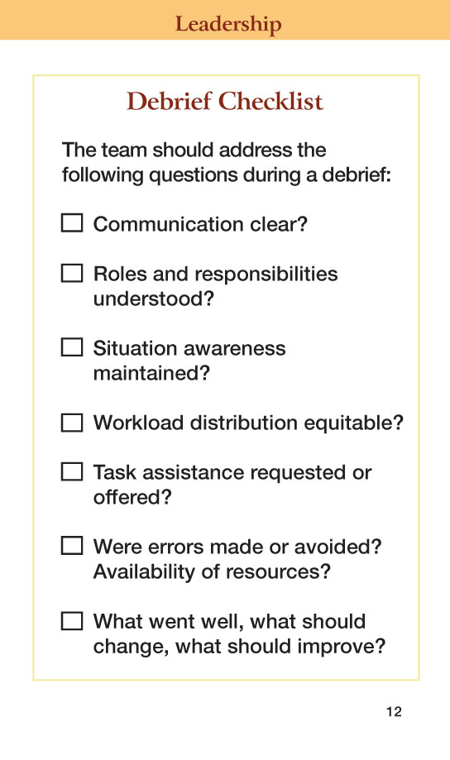
Notes:
This tool applies to ALL of us
It is very valuable in all environments
Do you need help? (Task Assistance)
After using the checklist, ask yourselves: “How did we do? What did we learn?”

Slide 67
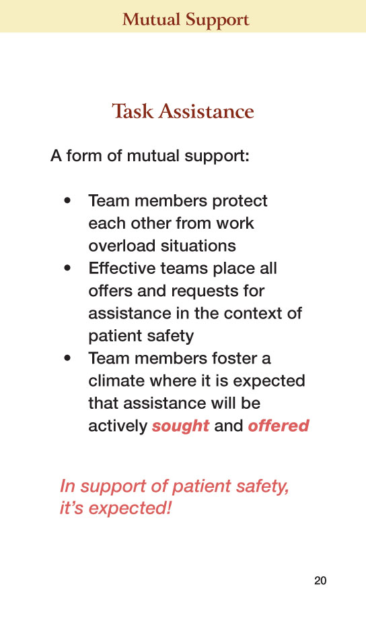
Notes:
We are hearing a lot about the need to rethink how we work
It’s going to be different – it already is…
We’re going to have to think about how my work ultimately effects our patients

Slide 68
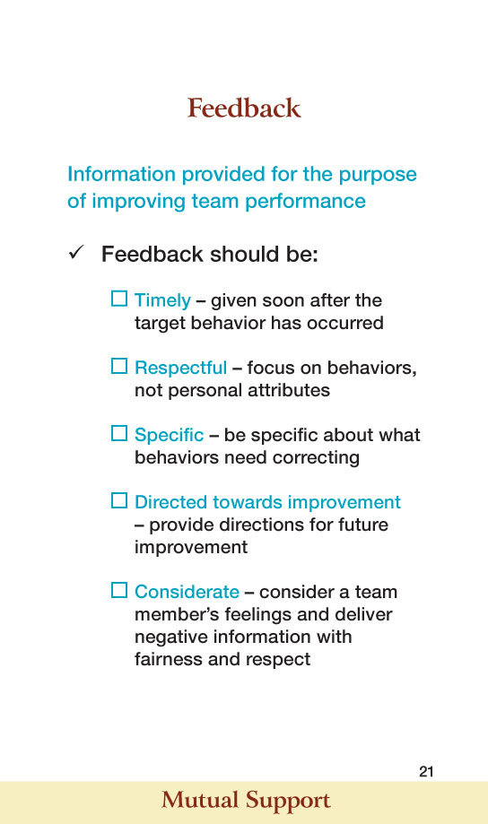
Notes:
Notes :
It is crucial that all our communications (verbal & non-verbal) are respectful
to others.

Slide 69
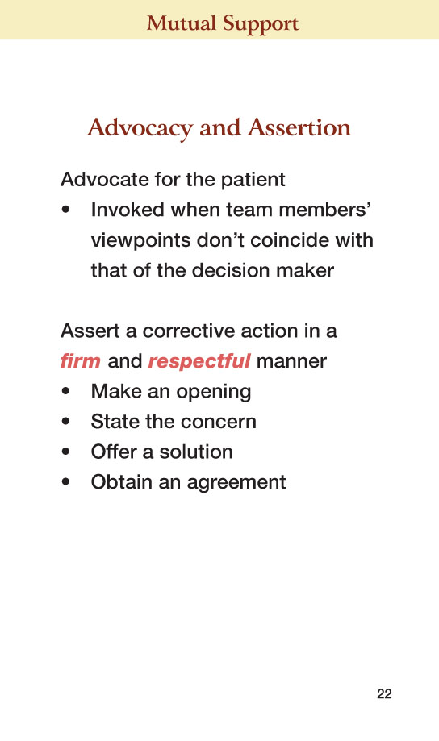
Notes:
Notes:
Remember respectful communication!
Scenario 1 – Nutritional Services
In Nutritional Services, colleagues understand how important it is to work as a team.
Everyone from the nutritional services aide, to the hostess, to the chef realizes their team plays a key role in ensuring patients get the nutrition that supports their healing.
Often, patients share with the nutritional staff their concerns or needs. As part of the overall care team, it is critical that the nutritional services staff share that information with the clinical staff.

Slide 70
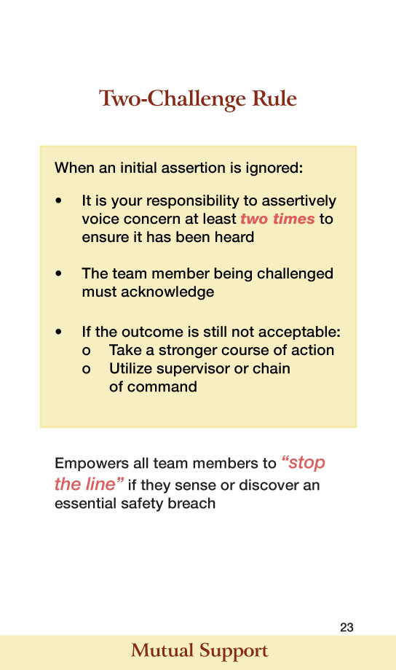
Notes:
Notes:
Responses from focus groups conducted in 1st Quarter 2013 did reveal some instances of staff not speaking up due to perceptions of what they thought other staff members response might be
Talk about “MORE OB” & Life Wings.
MORE OB promotes culture of safety
LIFE WINGS promotes teamwork and communication
Both advocate team members to say “STOP THE LINE” when they see a problem

Slide 71
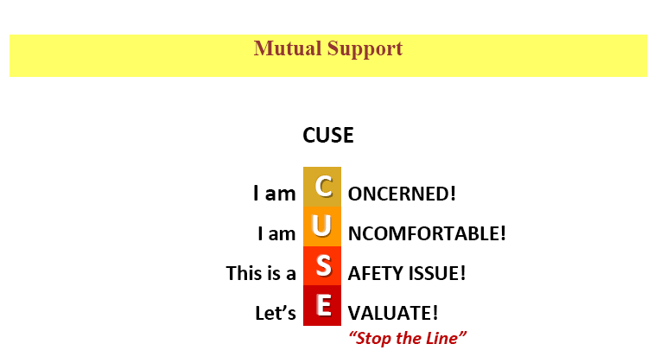
Notes:
Notes:
This tools, again, applies to all of us
In teamwork, it is so important that all members can rely on the support that is offered and provided by other team members
“CUSE” is one of these tools – when someone uses it, it literally means “stop – wait a minute – I’m concerned, I’m uncomfortable”
This doesn’t only apply to areas – it can be used in any of the health care setting

Slide 72
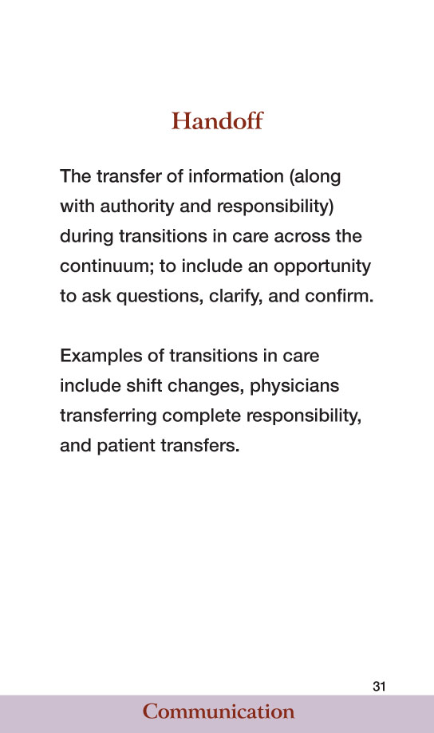
Notes:
Notes:
Results of the Hospital Survey on Patient Safety Culture (April 2012) indicates handoffs and transitions are opportunities for improvement.
Whenever we have done deep-dives on patient outcomes that weren’t what we wanted, it has frequently tied back to how the hand-off took place.

Slide 73
CHAT and SBAR
C | Current Condition Situation What is my major concern? | S
H | History Background What are the pertinent facts? | B
A | Assessment Assessment What do I think is the problem? | A
T | Treatment Recommendation What do I recommend that we do? | R
Reference: Geerlinks, P. (2013, January 30). Let’s chat. Retrieved from http://williamoslerhc.on.ca/workfiles/APR2009.pdf
Notes:
You can see the same skills in CHAT…
Essentially it’s the same as SBAR but easier to remember

Slide 74
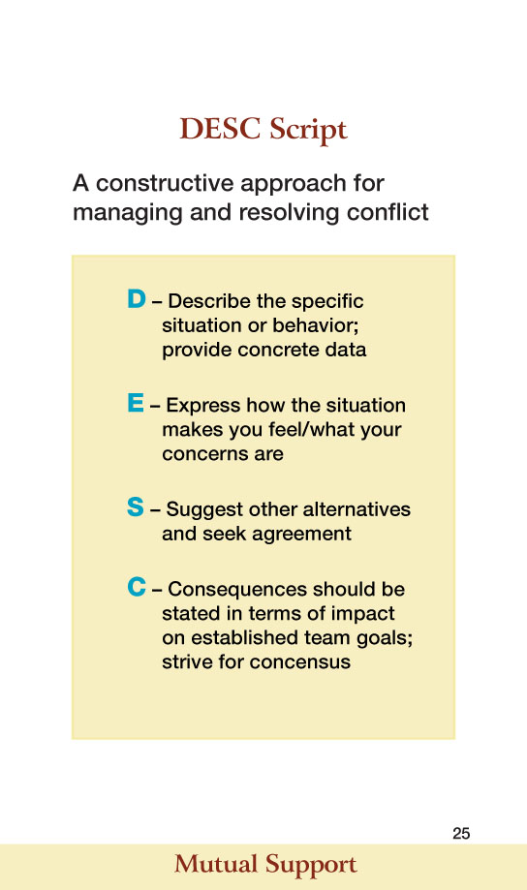
Notes:
Notes:
Recent Employee Satisfaction Survey results indicate a need for improvement in conflict resolution.
(Talk about the applicability of this technique in any setting – not only clinical)
Example:
Over the last couple of years, employee surveys have reflected that conflict resolution continues to be an area of opportunity for us as an organization – both within our departments and in our relationship with other departments. Utilizing this constructive approach (DESC) to manage conflict provides colleagues with a way to have productive discussion around concerns.

Slide 75
Patient Care Support Services
Service Recovery Program
Ethics Committee
Palliative Care
Spiritual Care
Patient Satisfaction Survey
Patient Rights
Patient Safety

Slide 76
SERVICE RECOVERY PROGRAM
All across the St. Joseph’s network, every employee, volunteer and physician is empowered to step in and turnaround situations of service failure with our patients and visitors.
Our mission expects us all to honor our sisters and brothers by listening to concerns and acting to “right any wrong.”
Research shows that patients that have had a service failure that is promptly and appropriately resolved have a greater degree of loyalty to the healthcare provider.
We use the acronym of ACT to respond to concerns and complaints.
We ask that all members of the medical staff share in our program of quickly responding to patient concerns.

Slide 77
SERVICE RECOVERY PROCESS
– Offer a blameless apology for the service failure
Take action to correct the situation or find those that can
Thank the patient or family for bringing forth their concerns
kits are available in all service areas and clinical units across the network. These kits have various tools or gifts to assist with easing the burden of service failures.
For example, if a patient has experienced a delay in receiving service, a certificate for complimentary parking may be offered. The tools vary across the network and are appropriate for both patients and families and inpatients and outpatients. Staff members also understand that in the case of severe service failures, these tools would not be appropriate and engaging management to start a formal grievance may best suit the situation.

Slide 78
Ethics consults
Why consult ?
  To help clarify moral dilemmas such as conflicts over treatment benefits, capacity of decision makers, withdrawal of life sustaining treatments in those without surrogates…
  To get input on the ethical pros and cons of options of care
  To support staff in moral distress over the care of a patient.
  Any member of the health care team, the patient or a family member can request an ethics consult.

Slide 79
Ethics consults
Who does the consult ?
  A member of an interdisciplinary consult group is on call Monday through Friday during working hours.
  Evenings and weekends the administrator on call is available for emergencies.
What does the consultant do?
  Contacts the person requesting the consult and reviews their concerns.
  Always contacts the attending physician
  Interviews all stakeholders and reviews the medical record
  May convene a family meeting if indicated.
  Writes a note in the medical record that includes pertinent legal as well as ethical standards.
  Consultants do NOT write orders or make decisions

Slide 80
Ethics consults
To request a consult:
  Place an order in the EMR (put “ethics” in search box)
  OR call administration at 448-5880 and ask for the ethics consultant’s phone number who is on call for the day
  Consultants will contact the requestor within 24 hours of the order.
For more information go to the intranet – references – ethics.

Slide 81
Palliative care is…
Comprehensive, specialized care focused on improving quality of life for patients and families living with serious and chronic illnesses.
Provided by an interdisciplinary team (physicians, social workers, nurses, chaplains)
Supportive care that can be provided along side of curative and remissive treatments.
Our physicians, nurse practitioners and nurses are all certified in Hospice and Palliative Medicine.

Slide 82
Call for a palliative care consult to:
Assist with Advance care planning (HCP, MOLST)
Establish goals of care
Provide expert pain and symptom management
Provide psychosocial and spiritual support for patients and their families
Facilitate family meetings
Extend your time – help with communication with patients and families.
Hospice referrals can be made directly by placing a social work consult and write in the reason area “Hospice”.

Slide 83
How to contact palliative care
Place an order in the EMR using “palliative care” in the search box
Office number is 448-5175 and is answered Monday through Friday and has voice mail for off hours.
Operator has on call schedule(NP or MD available 24/7 by phone)

Slide 84
SPIRITUAL CARE
Members of Spiritual Care provide spiritual and emotional support to patients, their families, as well as to the employees and volunteers of the hospital.
Spiritual Care is staffed by the Sisters of St. Francis, a priest, a religious Brother, lay employees and numerous volunteers.
Members of Spiritual Care visit and pray with all patients during their stay at St.
Joseph’s, regardless of one’s religious affiliation. If a non-Catholic patient wishes to see a clergy person of their own denomination, arrangements will be made.
Patient Advocates
Patient advocates are available in the Emergency Department to assist in the spiritual, emotional, and physical needs of patients and their families.cramental Ministry
Holy Communion is distributed daily to our Catholic patients.
The Sacrament of Reconciliation (Confession) is provided upon request.
The Sacrament of the Sick (Anointing with Holy Oil) is given to Catholic patients upon request.
Mass is celebrated in the hospital chapel every Sunday at 9:00 am, M-TH at 12 noon & Friday there is a communion service at 12 noon
The Chapel is open for prayer daily from 6 am to 8 pm.
Spiritual Care Ministry is available seven days a week, 24 Hours a day by calling:
8:00AM – 5.00PM: For immediate assistance please call 315-490-7311
5:00PM – 8:00AM: For immediate assistance please contact Administrative Coordinator at 315-448-5854
“Spiritual Care Consult” can be ordered via SJOrders

Slide 85
PATIENT SATISFACTION SURVEY
St. Joseph’s partners with Press Ganey Associates for our patient satisfaction survey process.
Surveys allow us to gather important feedback which we use to implement initiatives that help us to better serve our patients.
Important benchmarking data enables us to compare ourselves with like organizations and provides a tool to help us measure our status vs. world-class institutions, all with our vision of becoming “world-renowned for passionate patient care and outstanding clinical outcomes.”
Additionally, the survey enables us to comply with CMS standards for HCAHPS reporting. The Press Ganey surveys include our Inpatient, Outpatient, Homecare, Ambulatory Surgery, and Emergency Department.
Overview of survey process:
Patient information is securely transmitted to Press Ganey
Patients randomly selected to receive survey, within 3 days.
Completed surveys returned to Press Ganey
Within three days the data and comments are available on-line at www.pressganey.com - online reporting tools
Please contact the Patient Relations department at 448-5559 or patient.relations@sjhsyr.org to review patient satisfaction data or discuss our initiatives and best practices designed to increase satisfaction.

Slide 86
PATIENT SATISFACTION SURVEY
What does this mean for the Physician?
The surveys contain questions related to the patient’s perception of care provide by their physician.
These questions are:
  Time Physician spent with you
  Physicians concerns for questions/worries
  Physician kept you informed
  Friendliness courtesy of physician
  Skill of physician
Positive Comments regarding a specific physician are submitted for STAR awards and forwarded to the physician for review.

Slide 87
PATIENT RIGHTS
Patient Bill of Rights
Upon registration, patients and/or patient representatives are given the St. Joseph’s Hospital Patient Handbook showing the Patient Bill of Rights and Bill of Responsibilities in which patients are notified of their rights as patients. The handbook also includes the process to raise and resolve complaints and/or grievances. The hospital involves the patient in making decisions about their care, treatment and services including the right to have their own physician promptly notified of their admission to the hospital.

Slide 88
PATIENT RIGHTS
Advance Directives
Competent adults and emancipated minors have the right to provide instructions about future treatment should patients lose the capacity to make health care decisions. Such instructions may be in the form of a Health Care Proxy, Living Will or other written form or verbal instructions regarding health care. Patients may with Do Not Resuscitate (DNR) order or Medical Orders for Life Sustaining Treatment (MOLST) forms completed by a physician and reflecting the patient’s or authorized decision maker choices about life sustaining treatment.
Restraint Patients (or their Authorized Decision Makers) have varying preferences about the kinds of treatment desired as the end of life approaches. St. Joseph’s Hospital Hospital is committed to honoring these preferences, within the bounds of medically appropriate treatment and in light of applicable laws.

Slide 89
PATIENT RIGHTS
Advance Directives - continued
Patients have broad rights to refuse medical treatment, including life-sustaining treatment. If patients are incapacitated, the Authorized Decision Maker has the ethical and legal right to make decisions on the patient’s behalf. The standards for such decisions are, in order of preference:
1) The patient’s prior wishes;
2) Inferred from the patient’s values and beliefs (substituted judgment);
3) The patient’s best interests.
Refusal of medical treatment will be documented, as appropriate, by progress notes detailing the plan of care and completion of appropriate forms and Advance Directives (including MOLST forms) as described in this policy. DNR/DNI forms (and corresponding EPIC orders) will be used to document inpatient DNR/DNI orders.

Slide 90
PATIENT RIGHTS
Advance Directives - continued
All patients approaching the end of life will be offered the optimal relief of pain and other symptoms, and assistance with decisions regarding forgoing life sustaining treatments. The Palliative Care Team responds to requests by patients, families, or clinicians to assist in the provision of pain relief, symptom management, and comfort and assistance with clarifying goals of care. St. Joseph’s Hospital Hospital affords all patients, including those with developmental disabilities, full and equal rights and equal protection as provided for in applicable laws.
Ethics Consult
New York State requires a formal review mechanism for some medical decisions at the end of life. When disagreements arise about medical decisions at the end of life attempts to resolve them should first be made by calling an ethics consult.

Slide 91
PATIENT RIGHTS
Oral Disclosure of Confidential HIV
HIV status of a protected individual is confidential information that can only be disclosed with the protected individual’s or legal guardian’s authorization. A protected individual is defined as anyone who has been tested for HIV, regardless of the results.
Restraint
Non-Violent Restraints
The patient has the right to be free from restraints of any form that are not medically necessary. Restraints must never be initiated for staff convenience, as a substitute for adequate staffing to monitor patients, or as a coercive, disciplinary or retaliatory action against patients. Orders for restraints must be renewed daily for patients requiring ongoing restraints. Daily progress notes must adequately address the need for continued restraint use.

Slide 92
PATIENT RIGHTS
Interpreter Services
Consistent with the American with Disabilities Act, all patients and their companions have the right to be provided meaningful access to quality healthcare services regardless of race, religion, ethnicity, or national origin, including those persons who are limited English proficiency (LEP), hard of hearing, or visually impaired. For those meeting the criteria mentioned above, appropriate accommodations for communication must be made. These services are free of charge to the patient or their companion. These include, but are not limited to, translated documents (i.e., consent forms), CyraCom Interpreter Phones, and CyraCom Video Remote Interpretation Equipment for ASL. Documentation in the medical record must reflect use of interpretive services including, but not limited to, the refusal of offered interpreter services in lieu of a family member by the request of the patient.
Per the Interpreter Services Policy, staff cannot act as medical interpreters.

Slide 93
PATIENT RIGHTS
Restraint – continued
Violent Restraints
Violent patients may require restraints for the protection of the patient and staff. These should be considered a last resort with alternative, less-restrictive, measures considered first. Following the application of restraints, the physician must reassess the patient within one hour of application to assess the efficacy of the intervention. Restraints for violent patients must be assessed and documented by the physician on an hourly basis with nursing assessment occurring every 15 minutes. The physician assessment must include behaviors indicating need for ongoing restraints and possible alternatives to restraints.
Privacy and Security of Patient Information
1. Your access to patient information is granted in order to permit you to carry out your role responsibilities. Look at and share only the minimal amount of confidential information necessary to do your job.
2. When entering a patient’s room, ALWAYS ask the patient if it is OK for his or her visitor to be present for discussion about care.

Slide 94
PATIENT RIGHTS
Privacy and Security of Patient Information – continued
3. A healthcare proxy is entitled to patient information for healthcare decision-making only if the patient is incapacitated and can’t make his or her own decisions.
4. When someone inquires about the patient verify that the patient has given permission to talk with the individual.
5. Limit discussing patients in hallways and other open areas, by lowering your voice volume, moving away from other patients and visitors and using minimum patient identifiers.
6. When having discussions with patients or families minimize the chance of others overhearing by closing the door, and lowering your voice volume, and ask visitors to step out of the room.
7. Use the designated consult rooms in surgical waiting areas to discuss the patient’s status with his/her family.
8. Do not discuss or reveal patient information on social networking sites even if you are the only one who can identify the patient.

Slide 95
PATIENT RIGHTS
Privacy and Security of Patient Information – continued
9. Respect the privacy rights of employees who come here for care by affording their information the utmost confidentiality it deserves.
10. If you are not a member of the care and treatment team for a specific patient, you may not access information without the Attending Physician’s consent.
11. Photographs and other media recordings of patients require patient consent unless they are taken for care and treatment purposes.
12. Passwords are the most common form of authentication at St. Joseph’s Hospital and are often the only barrier for access to our sensitive and/or confidential information. Passwords must remain confidential to protect the security of our information.
13. It is important to not disable the anti-virus and/or anti-spyware software on St. Joseph’s Hospital computer system. There is potential risk for viruses and other malware programs that can affect the performance of your computer, the effectiveness of our network.

Slide 96
PATIENT RIGHTS
Privacy and Security of Patient Information – continued
14. Log-off your computer when you walk away from it; even if you only step away from your computer for a few minutes.
15. Users should not transmit and/or store sensitive and/or confidential information on file sharing or text messaging applications. As a result, you may be giving unauthorized individuals access to St. Joseph’s Hospital’s patient information.
16. Follow general guidelines for protecting portable devices, including iOS devices, Blackberries, and Laptops:
a. Password-protect your device - Make sure that you have to enter a password to log in to your mobile device;
b. Keep your valuables with you at all times - When traveling or at home, keep your device with you. Additionally, device left in unattended and locked vehicles is not considered a secure protection mechanism;

Slide 97
PATIENT RIGHTS
Privacy and Security of Patient Information – continued
16 - continued
c. Be aware of your surroundings - If you do use your laptop or mobile device in a public area, pay attention to people around you. Make sure that no one can see you type your passwords or see any sensitive information on your screen;
d. Back up your files to avoid losing all of the information. Make backups of any important information and store the backups in a separate location, preferably on St. Joseph’s Hospital systems. Not only will you still be able to access the information, but you'll be able to identify and report exactly what information is at risk.
17. Be wary of downloadable software - There are many sites that offer games and other software you can download onto your computer, iOS device, or mobile phone. This software could include malicious code.

Slide 98
PATIENT RIGHTS
Privacy and Security of Patient Information – continued
EMTALA
(Emergency Medical Treatment and Active Labor Act as mandated in 1986)
St. Joseph’s Health will comply with all applicable standards of care and federal and State Laws and regulations governing the provision of emergency services and transfer of patients between medical facilities. This applies to any individual presenting to an Emergency Department or on hospital property’s main building or located within 250 yards of such. Emergency Care is defined as medical screening by a qualified medical provider.

Slide 99
PATIENT SAFETY
Procedure Verification/Consent
Changes to the informed consent policy were made to ensure consistent practice and patient safety between campuses and to comply with New York State DOH regulations. This applies to both adults and children The process for procedure verification and consent applies to ALL clinical settings and invasive procedures that pose more than minimal risk, including: special procedure units, endoscopy units, catheterization laboratories, interventional radiology suites, intensive care units, labor and delivery areas, emergency departments, bedside procedures, CT scans, and all clinical units.

Slide 100
PATIENT SAFETY
Operative Notes
An operative report describing techniques, findings, and tissues removed or altered shall be dictated or documented, and authenticated by the physician immediately following the procedure. This must occur prior to the patient being transferred to the next level of care (i.e., before the patient leaves the PACU). In the event that this cannot be dictated within this timeframe, a brief postoperative note is required to be documented.

Slide 101
PATIENT SAFETY
Operative Notes
An operative report describing techniques, findings, and tissues removed or altered shall be dictated or documented, and authenticated by the physician immediately following the procedure. This must occur prior to the patient being transferred to the next level of care (i.e., before the patient leaves the PACU). In the event that this cannot be dictated within this timeframe, a brief postoperative note is required to be documented. This shall include all of the following elements regardless of applicability to the procedure performed:
The surgeon and assistants;
Pre-operative and post-operative diagnosis (post-operative diagnosis of “same” is not permitted);
Procedure(s) performed;
Specimens removed;
Estimated blood loss;
Complications (if any encountered);
Type of anesthesia administered; and,
Grafts or implants (if none post-operative note should reflect “none”)
For your convenience, a brief operative note template has been created and is available for use.

Slide 102
PATIENT SAFETY
Event Reporting
Adverse events are to be reported using the MIDAS QATF system. This is a peer review protected, confidential, electronic tool to report and collect events that involve or pose potential for harm solely for the purpose of quality assurance and patient safety. Access to event reports are not provided to patients, their representatives or third parties
ISO 9001: Quality Management System (QMS)
As part of our hospital accreditation with DNV, St. Joseph’s is ISO 9001 certified. Through integration of CMS Hospital Conditions of Participation (CoPs) and ISO principles, an overarching quality management system has been created. ISO provides the structure to ensure the continual improvement of our key processes and achievement of our strategic goals, thus improving the care we provide. The three objectives of ISO 9001 are:
Consistent care
Customer satisfaction
Continual improvement

Slide 103
Medication Management
  Bernie Delello, Director
Corporate Compliance
  Regina McGraw, Vice President and Chief Compliance Officer
Quality Resources
  Chris Jordon, Director

Slide 104
PHYSICIAN ORDERS POLICY:
All orders for medications, treatment & tests shall be entered into EPIC.
Order sets must be used for treatment doses of all anticoagulants to ensure consistent patient monitoring occurs during hospitalization.
Indication is required for all Antibiotic orders to ensure appropriate use and to support antibiotic stewardship.
Indication is required for all as needed (PRN) orders
Reconcile prior to admission medications

Slide 105
MEDICATION TURNAROUND TIME
STAT
STAT orders require verbal notification of the charge nurse or medication nurse. The use of “STAT” should be limited to drugs needed in emergent situations. STAT orders receive complete priority and attention and are to be handled as rapidly as is safely possible.
STAT order turn around time: The item will be ready for pickup in the pharmacy within 5 minutes (non-compounded) or 10 minutes (compounded) of receiving the order in the pharmacy. The medication should begin administration within 30 minutes or as soon as patient preparation allows
URGENT/ASAP/NOW Administered within 60 minutes or as soon as the patient preparation allows
ROUTINE ORDERS (all orders not written as STAT, URGENT, ASAP, or NOW) First doses are to be administered within four (4) hours from the time the order is written

Slide 106
VERBAL ORDERS
Verbal orders should be limited to urgent situations where immediate written communication is not feasible
Verbal/telephone orders may not be given for chemotherapeutic agents.
Except in emergency situations, verbal orders may not be enacted until the authorized individual receiving the verbal order has completed “read-back” verification with the ordering practitioner

Slide 107
ACTIVE MEDICATION ORDERS THAT REQUIRE ACTION TO CONTINUE
Orders started before surgery and must be acted upon in SJ ORDERS or completely rewritten by the prescriber. “Resume pre-op orders” is not acceptable.
Orders for patients when the patient is transferred into or out of the SICU/MICU/L&D/ICN must be acted upon in SJ ORDERS or completely rewritten by the prescriber.
The following medications must be renewed at defined intervals or they will be automatically discontinued.
Controlled substances standing and defined as needed – 7 days
Intravenous heparin 7 days (no automatic stop for subcutaneous heparin or subcutaneous enoxaparin/Lovenox).
Blood products dispensed from the pharmacy (albumin, factors) – 3 days
Warfarin – 1 day
Ketorolac – 1 day
A medication order that is put “on hold” by a prescriber will be discontinued unless it is put on hold for a specific time period. Example “hold” furosemide dose this morning.

Slide 108
MEDICATION ADMINISTRATION SCHEDULE
Timing of routine orders specified by number of doses per day.
  a. The following administration schedules will be used:
    qday (daily) = 0900
    bid = 0900 - 2100
    tid = 0900 - 1400 - 2100
    qid = 0900 - 1300 - 1700 - 2100
    hs = 2100
Doses ordered in between will be administered according to the First Dose or Missing Dose Medication

Slide 109
What is Corporate Compliance &
Why Is It Important?
Corporate Compliance means having internal processes designed to prevent and detect violations of applicable laws, rules, regulations and ethical standards by members of the workforce and others. This includes billing for services provided.
A successful corporate compliance program:
  Addresses the public and private sectors’ mutual goals of reducing healthcare fraud, waste, and abuse.
  Demonstrates a commitment to honest and responsible corporate conduct.
  Enhances health care providers’ operations.
  Helps to fulfill one’s legal duty to refrain from submitting false or inaccurate claims and other illegal practices.
  Increases the likelihood of preventing, identifying, and correcting unlawful and unethical behavior at an early stage.
  Encourages individuals to report potential problems to allow for appropriate internal inquiry and corrective action.
  Minimizes any financial loss to government and taxpayers as well as any corresponding financial loss to the hospital a/o physician due to early detection and reporting.

Slide 110
8 ELEMENTS OF A COMPLIANCE PROGRAM
In New York State, Compliance Programs are required to have 8 elements:
  Written Standards of Conduct (i.e. Business Conduct & Code of Ethics)
  Compliance Officer and other appropriate bodies (i.e. Corporate Compliance Committee)
  Non-retaliation & Non-intimidation Policy for reporting concerns
  Education and Training for the workforce
  Internal methods for reporting concerns and complaints
    Including a way to report concerns anonymously (Compliance Hotline: 448.6484)
  Internal methods for responding to concerns and complaints
  Internal auditing to monitor compliance
  Investigation and correction of identified problems

Slide 111
HIGH PROFILE LAWS YOU SHOULD BE AWARE OF
False Claims Act (FCA) – Individuals and entities are prohibited from filing false or fraudulent claims for payment.
  Federal Level - Imposes penalties and fines on individuals and entities that file false or fraudulent claims for payment from Medicare, Medicaid or other federal health programs.
    Allows private individuals to file lawsuits in federal court, just as if they were federal prosecutors. If the suit eventually concludes with payments back to the government, the person who started the case can recover a percent of what the court awarded.
    Fines and penalties for violating the FCA are very high.
  NYS Level - Imposes penalties and fines on individuals and entities that file false claims for payment from any state or local government program, including Medicaid.
    Some of the laws apply to people who receive false services (i.e. patients) and some apply to people to bill false services (i.e. hospitals, physicians, diagnostic centers).

Slide 112
HIGH PROFILE LAWS YOU SHOULD BE AWARE OF
Stark Law - Prohibits a physician from referring patients who have Medicare or Medicaid for certain "designated health services" to an entity that a physician or an immediate family member has a "financial relationship.“
  Physician self-referral is the practice of a physician referring a patient to a medical facility in which he (or an immediate family member) has a financial interest, be it ownership, investment, or a structured compensation arrangement.
  There are many exceptions. Contact a healthcare attorney or the Compliance Office for more information on exceptions.
  Due to the nature of this law, a physician who cannot meet an exception commits a violation of the law simply by engaging in a prohibited referral, regardless of his or her intent or lack of knowledge of the law.
  There are two laws in NYS that are similar
    PHL Section 238-A.1(a)
    NYS Education Law Section 6530.18
  The Anti-kickback Statute is very similar to STARK. One of the main differences is that the Anti-kickback Statute has the ability to not only impose monetary penalties but criminal penalties as well.
  Contact the Compliance Office for more information

Slide 113
HIGH PROFILE LAWS YOU SHOULD BE AWARE OF
The Health Insurance Portability and Accountability Act (HIPAA)
  Privacy & Security Rule - protects the privacy & security of patient information
  In general, patient information may be disclosed without a patient’s authorization for:
    Treatment
    Payment
    Health Care Operations
  If the disclosure does not meet one of these 3 categories, a patient authorization is required.
  Violations could result in termination of privileges, legal action against the individual and the hospital, monetary fines and prosecution.
  Under the HITECH Act, in most instances Providers are required to notify a patient when a breach of their information has occurred.
    Contact the Compliance Office right away if you believe a patient privacy or security violation has happened.

Slide 114
HIPAA Best Practices
Use caution with electronic devices (i.e. mobile phones, pagers, laptop computers)
Telephones - Be aware of your surroundings (Who could be listening to your conversation?)
When discussing patient information use a private space, talk quietly and limit what you say. Please be aware that patients and family members can hear your conversations when you are standing at the POD areas.
Use private dictation rooms to help prevent unnecessary disclosures. We have Physician designated workspace on each unit for this purpose.
Don’t leave medical records or patient information lying out unattended or visible on a computer screen that you are not in attendance of.
Curtains should always be drawn while providing care to patients.

Slide 115
HIPAA Best Practices
Limit printing and immediately shred/destroy documents no longer needed. Please use the confidential waste bins located throughout the hospital & MD Lounge.
Never access information concerning patients, another physician, employees, or family members unless it is needed to perform your assigned job or to provide care to the patient.
Feel free to ask patient’s families/friends and the patient’s roommate’s families/friends to leave before discussing information with a patient.
Ask patients who they would like you to talk to about their care.
Check the consent section of the chart for restrictions and allowable disclosures (if there is a PHI alert sticker on the chart).
If you’ve learned something in the course of doing your job, it should be kept confidential.

Slide 116
ST. JOSEPH’S ACCREDITATION PROGRAM
St. Joseph's is accredited b
DNV Healthcare is committed to improving the quality and safety of care provided by health care organizations.
Accreditation means that the Hospital has demonstrated compliance with organizational, patient care and safety standards set forth by DNV Healthcare.
Accreditation with DNV standards is the foundation of St. Joseph’s quality management system.
For more information about DNV Healthcare Inc., visit their website at www.DNV.com
Safety or Quality Concerns? If you have a concern or complaint about patient care or safety, please share this directly with those providing the care. If you are uncomfortable doing this or you do not feel that your concern has been adequately addressed, you may contact the Department Chair Person. If you continue to feel that your concern has not been adequately addressed, please contact St. Joseph's Vice President for Medical Affairs.
  If you are still not satisfied with the response, you may report your concern or register a complaint with the following:
DNV Healthcare Inc.
Phone 1-866-496-9647
E-Mail: http://dnvglhealthcare.com/patient-complaint-report

Slide 117
RESOURCES TO HELP NAVIGATE THE SYSTEM
St. Joseph’s Business Conduct & Code of Ethics
Regina McGraw, Vice President and Chief Compliance Officer (448-6501)
Compliance Office (448-5756)
Policies and Procedures
  Medical Staff Conflict of Interest Policy
Hospital Intranet
  Corporate Compliance Website
Hospital Internet
  Compliance Webpage

Slide 118
CONTACTING THE
COMPLIANCE OFFICE
The Compliance Office is located on the Hospital’s main campus, 201 Prospect Ave., 2nd Floor, offices 214-216. You can reach the Compliance Officer (Amy Rhone) in the following ways:
  Email: amy.rhone@sjhsyr.org
  Telephone: 448-6501
  Hotline # (anonymous way to report concerns): 448-6484
  Write a letter
  Complete a Corporate Compliance Notification Form (#11607).
  Stop by the office and talk in person. Office is open Monday – Friday from 0730 – 1630.
  After hour appointments are available upon request.

Slide 119
We Are Committed to Those That Report Concerns
You are required to report concerns that you have
  You are the front line of defense. We need you to tell us what is not working right or when something goes wrong.
For more information, or to talk about a concern, contact the Chief Compliance Officer (Regina McGraw, 448-6501)
Other individuals to address concerns to:
  The Department Chairman; or
  The Vice President for Medical Affairs; or
  The Medical Staff Director for Corporate Compliance (Vice President for the Medical Staff)
To report a concern confidentially or anonymously
  Corporate Compliance Hotline: 448-6484
  You cannot be punished or intimidated when you report a concern in good faith.
  If you think you are being retaliated against for reporting a concern, contact the Compliance Office.
  “Do The Right Thing EVERY TIME”

Slide 120
PATIENT SAFETY & RISK MANAGEMENT
Patient Safety is the responsibility of all caregivers at St. Joseph’s Hospital Health Care System.
All employees, medical staff and affiliates are obligated and expected to participate in the organization-wide occurrence reporting process by reporting all actual events (and near miss events) they identify.
This organization is committed to a proactive, system-focused, no-blame approach to medical error reporting.
Every unexpected event, actual or near miss is to be reported within 24 hours regardless of whether or not there was harm or injury to the patient. Occurrence Reporting Policy.
Occurrence: An occurrence is any event that is not consistent with the routine operation of the hospital or the routine care of a particular patient. It may be an accident or an event which has caused physical or emotional harm to a patient, or has the potential risk thereof.
Medical error: The failure of a planned action to be completed as intended (i.e., an error of execution) or the use of a wrong plan to achieve an aim (i.e., an error of planning)
Near Miss: An event that did not reach the patient. The event almost happened but was intercepted (or caught) before it had the chance to reach the patient. A near miss could be a warning sign of a significant system problem.
The electronic reporting system, MIDAS-RDE, can be accessed by all staff, employees, medical staff, and affiliates via the hospital intranet (SJen under Works Tools). Select the appropriate QATF (Quality Assessment Tracking Form) under Risk Form and complete all fields.

Slide 121
PATIENT SAFETY & RISK MANAGEMENT
Immediately notify Risk Management staff at 448-5157 for any occurrence where the patient has sustained a serious injury or unexpected death. Voice mail messages left must include: date and location of event, medical record number and a brief description of the event. After hours, or when a Patient Safety and Risk Management staff member is not available, a cell phone number to contact the Director of Quality Resources is provided.
When an event results in harm to a patient or staff member, or a significant risk thereof, sequester all materials proximal to the event. For any questions regarding the sequestering of evidence contact the house Administrative Coordinator.
Examples of events to report include but are not limited to:
  Any treatment or procedure (including an omission or delay) for which there is an unexpected adverse outcome
  Complications of diagnostic or therapeutic treatment when they occur
  Unexpected death
  Wrong site/wrong patient/wrong procedure events
  Events occurring as a result of malfunction or failure of a medial device
  Medication error
For additional specifics of events to report, see the Occurrence Reporting Policy

Slide 122
PATIENT SAFETY & RISK MANAGEMENT
Narrative descriptions of the unexpected events on the QATF should:
  Be objective
  Be clear and concise
  Avoid use of staff name(s) in narrative
  State only the detailed circumstances of the event
A root cause analysis (RCA) will be conducted for events that are:
  A significant near miss
  A sentinel event
  NYPORTS event
  Never Event/Serious Reportable Event
  Other significant event
Note: A single event may in fact fall into multiple categories
You may be asked to be a participant on a RCA team should a significant event occur with one of your patients or your expertise is needed in relation to an event.
For any questions or assistance please call the Patient Safety and Risk Management Service at 423-6883
Safety Starts with You!

Slide 123
Falls
We track & monitor all patient falls and severity of injury
Nurses assess patients fall risk daily
Nurses required to notify MD’s when a patient falls
MD & nurse to review plan of care, medications, & make adjustments as necessary

Slide 124
PERFORMANCE IMPROVEMENT
The Medical Quality Council membership is comprised of a physician and alternate from each of the medical services and is chaired by the Medical Director of Performance Improvement.
The committee’s function is to:
Provide a forum for resolution of multidisciplinary patient care related issues.
Improve the quality of care through a systems analysis approach utilizing performance improvement project team.
Provide a forum for ongoing review of policies and procedures related to the peer review process.
The department chairs or their designee(s) may also serve as “Chief Peer Reviewers” for their service and may refer multidisciplinary issues to the MQC for discussion and resolution (see peer review process).
Meetings are held no less than 9 times per year. Activities of the council are reported to the PISC, Medical Executive Committee and the Board of Trustees on a regular basis.

Slide 125
PERFORMANCE IMPROVEMENT
Performance Improvement Project Teams:
Multidisciplinary workgroups are convened when specific opportunities for improvement are identified for intensive assessment by the PISC. Each workgroup is chaired by a physician appropriate to the project specialty and is facilitated by a Quality Improvement Advisor. Membership and frequency of meetings is determined by the focus of the initiative.
PeeThe goal of the peer review process is to ensure that the hospital, through the activities of the medical staff, assesses the ongoing professional practice evaluation (OPPE) of individuals granted clinical privileges and uses the results of such assessments, when necessary, to perform focused professional practice evaluation (FPPE) and improve patient care. Peer review is conducted on an ongoing basis and reported in summary to the Medical Quality Council for review and action. The procedure for conducting a peer review of an individual case and for the collection of aggregate performance measures are described in the Medical Staff Peer Review Policy.

Slide 126
Surgical Care Improvement Project (SCIP)
Antibiotic d/c’ d within 24 hours (48 hours for cardiac surgery) of surgery end time unless documented infection/suspected infection
Reason for continuing antibiotic must be documented as an infection/suspected infection within 48 hours (72 hours for cardiac surgery). Documentation of symptoms (increased WBC, fever) are not adequate
If patient was on a beta-blocker prior to admission and does not receive a beta-blocker while in hospital, please document reason why it is being held
Must take glucose closest to 6am on POD #1/POD #2, whether before or after
Foley catheter must be removed on POD #1/POD #2. Documentation for reason for leaving catheter (i.e. please leave Foley catheter to monitor I & O, monitor hematuria). Must be linked to reason (Order to leave Foley is not enough)!
Temperature must be documented within 30 minutes prior to or 15 minutes after Anesthesia End Time
Document Venous Thromboembolism Prophylaxis ordered (should be ordered within 24 hours prior to surgery to 24 hours after surgery unless contraindicated). Document contraindications (i.e. GI bleed is a contraindication to pharmacological prophylaxis)
Use of surgical progress notes will assist in meeting CMS documentation guidelines (Form # 13530, and Form # 13540)

Slide 127
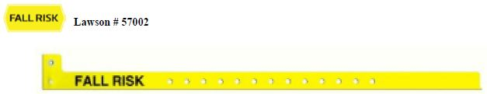

Colored Bracelets to Alert Caregivers of Patient Special Needs
Yellow
Fall Risk- Alerts the caregiver that the patient has fallen either prior to hospitalization or during the current hospitalization.
Purple
DO NOT RESUSCITATE (DNR) - Alerts the care giver that the patient has a medical order order NOT to be resuscitated.

Slide 128
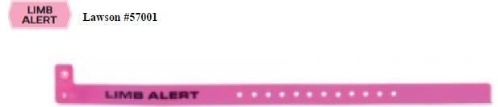
Pink
Limb Alert - Alerts the caregiver that this particular extremity should not be used for blood pressures, IV’s, venipunctures, injections or any other procedure which might compromise the extremity. Unless a specific medical order is obtained, the extremity is not to be used.
Indications for a PINK bracelet include:
An invasive procedure i.e. cardiac catheterization or any interventional procedure using a brachial approach
Post-mastectomy
Post axillary surgery
Functioning arteriovenous shunt or fistula
Paralysis
Traumatized, diseased or compromised by vascular or neurological impairment
Recent surgery, cast or bulky dressing
PICC lines
Click Here for the Alert Bracelets Policy

Slide 129
AHD – Advance Health Directive
MOLST- Medical Orders for Life Sustaining Treatment
DNR – do not resuscitate
Consistent with our belief that competent adult patients have the primary right and responsibility for decisions concerning their health, we are obligated to institute measures to comply with their wishes for treatment choices, preferred surrogates, statements regarding wishes concerning quality of life, resuscitation or other life sustaining treatment (LST).
Click Here for the Advance Health Directives (AHD) policy
Click here for the MEDICAL ORDERS FOR LIFE SUSTAINING TREATMENT (MOLST) Do Not Resuscitate (DNR) policy
Consent to the writing of a DNR order does not constitute consent to withhold or withdraw medical treatment other than CPR. Furthermore, a DNR order does not preclude an individual from requesting certain resuscitative interventions, including, but not limited to Heimlich maneuver, medication for arrhythmias, and intubation for respiratory distress.
The MOLST form is a Department of Health (DOH) form, DOH-5003 6/10/Lawson Form #11004. The original form is bright pink in color.
The MOLST form is considered a Physician’s order sheet. It is completed based on the patient’s current medical condition and wishes as well as summarizing advance directives including resuscitation status as well as other orders for LST.
MOLST form does not always mean DNR.
The MOLST form also serves as a Non-Hospital DNR and DNI order in New York State.

Slide 130
AHD/MOLST/DNR
MOLST and other advance health directive documents are to be filed in the AHD SECTION of the medical record.
Patients will have a BLUE DNR bracelet applied when a valid DNR order has been received.
A DNR order may only be written by a licensed physician. A verbal order may be taken by an RN, clinical affiliate or unlicensed physician (resident) and documented on the MOLST form, however this must be signed by the attending physician within 24 hours.
Physician must document discussion in the medical record and complete appropriate check list.
If a patient /authorized person Rescinds/REVOKES his/her consent to DNR/MOLST orders at any time by an oral or written declaration made to a physician or ANY member of the care team, or by any act evidencing intent to revoke consent:
1. The RN will immediately notify the attending physician, if not present, and document notification in the medical record.
2. The RN will remove the BLUE DNR bracelet when the attending physician has been notified.
3. It is the attending physician’s responsibility to provide an order to rescind/revoke the
DNR/MOLST order. VOID must be written across all sections of the MOLST form and dated and
initialed by health care practitioner.
4. The attending physician must amend Section F indicating either ‘form voided, new form
completed’ or ‘form voided, no new form’.

Slide 131
Brain Death Determination
BRAIN (NEUROLOGIC) DEATH DETERMINATION Link to policy
St. Joseph’s Hospital Health Center (SJHHC) has established and implemented written policies for determining brain death, including:
Reasonable accommodation of an individual's or Surrogate Decision-makers religious or moral objection to use of the brain death standard to determine death;
Privileging physicians to make brain death determination in accordance with accepted medical standards;
Notification of the next of kin or other person closest to the patient (collectively, the "Surrogate Decision maker") that brain death determination is in progress;
The tests and procedures required for determining brain death.
Privileging Requirements for Determination of Death Using Neurologic Criteria
Be an active member of the St. Joseph’s Hospital Health Center Medical Staff.
Be familiar with the Neurologic Criteria for Determination of Brain Death
Be able to perform a neurologic evaluation utilizing the criteria as stated in this policy.
This privilege is considered to be a core privilege for Physicians who are Board Certified in Neurology, Neurosurgery, Neonatology or Critical Care Medicine.
List of physicians privileged is found in intranet under Organ Donation Web site.

Slide 132
Certification of Brain Death
At St. Joseph’s Hospital Health Center (SJHHC), Determination of Death by Neurologic Criteria will be performed by one physician privileged to make brain death determination utilizing the Death Certification by Neurologic Criteria checklist.
Before a patient can become an organ donor in this institution, two physicians are required to certify the time of death. The second physician will review and affirm that the medical record and data fully support the determination of brain death. Both physicians must be privileged at this institution. NYS law requires that the time of brain death must be certified by the physician who attends the donor at his death and one other physician, neither of whom shall
participate in the procedures for removing or transplanting organ(s).
Any aspect of the clinical assessment, apnea test, or ancillary test (if applicable) may be performed again if the second physician believes it is indicated to make his or her determination concerning brain death.
All phases of the determination of brain death must be documented in the medical record utilizing the checklist Death Certification by Neurologic Criteria.
http://intranet/network2000/mrforms/pdf_forms/13564.pdf.
The medical record must also indicate:
Etiology and irreversibility of coma
Absence of cerebral responsiveness
Absence of brain stem reflexes
Absence of respiration with PaCO2 ≥ 60 mm Hg (or ≥ 20 mm Hg increase over baseline normal PaCO2)
Justification for, and result of, ancillary tests if used

Slide 133
Death Pronouncement
New York State requires specific documentation regarding death pronouncement when a patient expires.
If you consistently use form #20037 from the forms catalog or forms on demand (FOD) this requirement will be met.
If the form is not used the information required to be documented will still be expected.

Slide 134
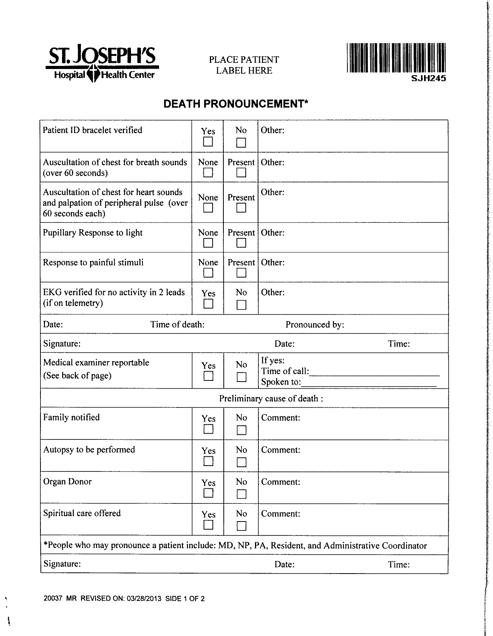

Slide 135
Care of the Substance Overdose Patient
Poison Control (PC) must be contacted (required documentation)
  For all intentional and unintentional overdoses
Document PC’s recommendations (required documentation)
  If not following PC’s recommendations must document why in the medical record
Labs
  Standard overdose lab panel
  Test for other drugs as recommended by PC
  Repeat labs as needed or recommended
Order a Pharmacy consult for expected ICU/PCU stays >24 hours
Order a Psychiatry and/or Neurology consult as indicated
Click here to review full policy

Slide 136
Antibiotic Stewardship
10 things to know - Prescribers
The CDC reports that 20-50% of all antibiotics prescribed in U.S. acute care hospitals are either unnecessary or inappropriate. This increases the risk of serious side effects and Clostridium difficile infection.
To decrease unnecessary and inappropriate antimicrobial use, St. Joseph’s Health has an Antibiotic Stewardship Team that includes a pharmacist and a Infectious diseases physician who review antimicrobial use Monday through Friday. Positive cultures are reviewed 7 days a week.
It is not only the type of antibiotic that increases the risk of C. difficile (high risk: ciprofloxacin, levofloxacin, clindamycin, ceftriaxone, cefepime, ertapenem, meropenem) but also the number of antibiotics prescribed and the duration of therapy.
A Best Practice Alert (BPA): Antibiotic Time Out will appear in the order section after an antibiotic has been prescribed over 48 hours. At this time consider:
  Does the patient have an infection that will respond to antibiotics?
  Is the patient on the right antibiotic(s), dose, and route of administration?
  Can a more targeted antibiotic be used to treat the infection (de-escalate or streamline)?
  How long should the patient receive the antibiotic?

Slide 137
Antibiotic Stewardship
10 things to know - Prescribers
The antibiotic stewardship team reviews bacterial resistance trends for various organisms. For example, only 75% of our E. coli isolates are susceptible to ciprofloxacin or levofloxacin. We provide an inpatient, outpatient, and nursing home antibiogram yearly and it is available on the EPIC dashboard.
To help with appropriate antibiotic prescribing and laboratory testing we have developed Pneumonia, Sepsis, and C. difficile order sets. Recommendations are evidence based and guided by our antibiotic sensitivities.
The recommended duration of antibiotic therapy for treatment of Community & Hospital–acquired Pneumonia is 5 to 7 days. This also includes the time on oral
therapy.
Remember to review a patient’s profile for laxatives or stool softeners prior to ordering a C. difficile PCR test.
Note 70% of diabetic women and over 90% of the elderly from long term care facilities will have a urinalysis with pyuria (defined as >10 wbc/hpf). Patients should only be treated for a urinary tract infection if they have symptoms. Don’t treat asymptomatic bacteriuria!

Slide 138
Antibiotic Stewardship
10 things to know - Prescribers
10. The antibiotic stewardship team communicates their recommendations by:
  Phone call
  Sticky notes in EPIC
  Or during rounds
  If you have questions or suggestions for the stewardship team contact Lisa Avery, Pharm.D. at 86177.

Slide 139
Important Policies
Click To Review
Dignicare Stool Management System
Hypertonic Saline in Non-Surgical Hyponatremia (Adults)
Patient Consent Policy
Organ Donation After Circulatory Death
Organ Eye Tissue Donation
All hospital policies and procedures can be found on the hospital intranet at: http://sjen.sjhsyr.org/policies/default.aspx

Slide 140

Relationship-Based Care:
A Model for Transforming Care at the Bedside
A focus on: patients, colleagues, & self.
Clinical units are establishing Unit Practice Councils to deliver RBC. You may be asked to provide input or be adopted as a consultant.
Facilitates Physician Rounds
  Consistent nursing care ensures more thorough familiarity with patient/family needs & responses to treatment
  Minimizes frequent phone calls & daily interruptions
  Streamlines patient flow
Helps Meet Physician Needs
  Improves environment for ease of workflow
  Advances care delivery through collaboration with nursing units
Improves Satisfaction Scores
  Press Ganey (Patients)
  Physicians
  SJHHC Staff
Increases Revenue
  Performance Improvement
  Satisfied patients are more likely to return to MD service
  Potential growth of clientele base
  Better patient flow allows more patients to be seen
Nurtures Collegiality
  Relationships develop living collaboration
  Promotes a healthy work environment
  Aligns with Mission, Vision, Core Values, & Strategic Plan

Slide 141

ST. JOSEPH’S HEALTH FOUNDATION
St. Joseph’s Health Foundation's primary purpose is to raise funds that will be used to enhance patient care and comfort throughout St. Joseph’s Health's network of services. Some of the Foundation’s award-winning programs include:
150th Anniversary Campaign – As we approach the 150th anniversary of St. Joseph’s Hospital in 2019, the Foundation is looking to preserve and further St. Joseph’s Health’s legacy by raising funds for facility expansion and improvements to meet increasing medical and surgical needs of the region.
Circle of Caring - annual gifts membership program to raise funds for patient care programs throughout the St. Joseph’s system
1869 Society - gift planning ideas and information to help donors add St. Joseph’s Health to their estate plans
Special Events - Spring Gala and Fall Golf Classic open to all for the benefit of our patients
Walkways of Caring - naming opportunities in honor and in memory of loved ones
Mini-Grant Program-the purpose of the program is to encourage SJH staff to find innovative ways to enhance patient care. The Foundation provides grant money that staff may apply for an idea/program that they may have come up with for their department or unit, but never had the funding to implement it.

Slide 142
ST. JOSEPH’S HEALTH FOUNDATION
The SJH Foundation raises money and community awareness for St. Joseph’s Health and its many programs and services through a variety of means which include:
150th Anniversary Campaign
Annual Spring Gala Dinner Dance and Annual Golf Classic
Annual Giving Opportunities
Hospital endowment funds
Naming Gifts
In-Kind Giving
Grateful Patient fund-raising
The Foundation can also assist with grant applications for programs/projects
The Foundation also welcomes your assistance to identify prospective donors!
For more information, call Vince Kuss, VP for Development at 703-2189 or visit www.sjhsyr.org/foundation

Slide 143
Thank You- Please Complete:
Physician Orientation Attestation/Acknowledgement Form
Physician Orientation Evaluation

